Slide 1
Design, Develop, Implement, Test & Document Used Car Sales Portal Website
Module Project
Module: Application Development & Process
Start Date : January 30 2023
End Date : February 17 2023
Submission Date : February 17 2023
Learner Name : I Kadek Adi Astawa
Enrollment ID : BDSE06
Presentation Date : February 20 2023

Slide 2
Contents
Document History
Version Number | Effective Date of release | Summary of Included Changes | Author

Slide 3
Contents
Contents
S. No. | Description
01 | List of software used
02 | Business Process
03 | Project Plan
04 | Stages of Risk Based Testing models
05 | Types of risks
06 | Risk Based Testing Strategies
07 | Qualitative and Quantitative Risk Analysis
08 | Security Testing
09 | Test plans and Test cases
10 | Logs of Test Results
11 | Modifications of fail Test Cases
12 | Effectiveness of RBT strategy
13 | Project Results

Slide 4
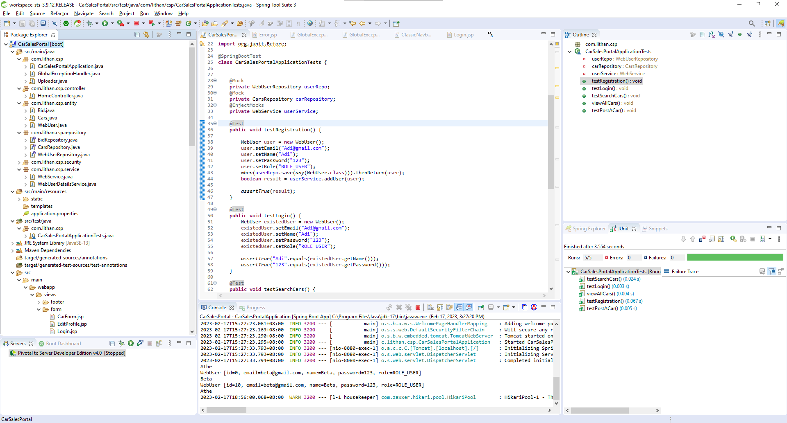
1. List of software used
Spring Tool Suite 3

Slide 5
1. List of software used
Service

Slide 6
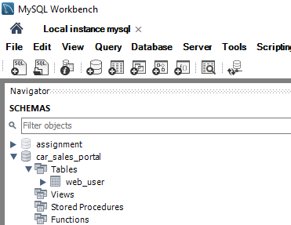
1. List of software used
Mysql Workbench

Slide 7
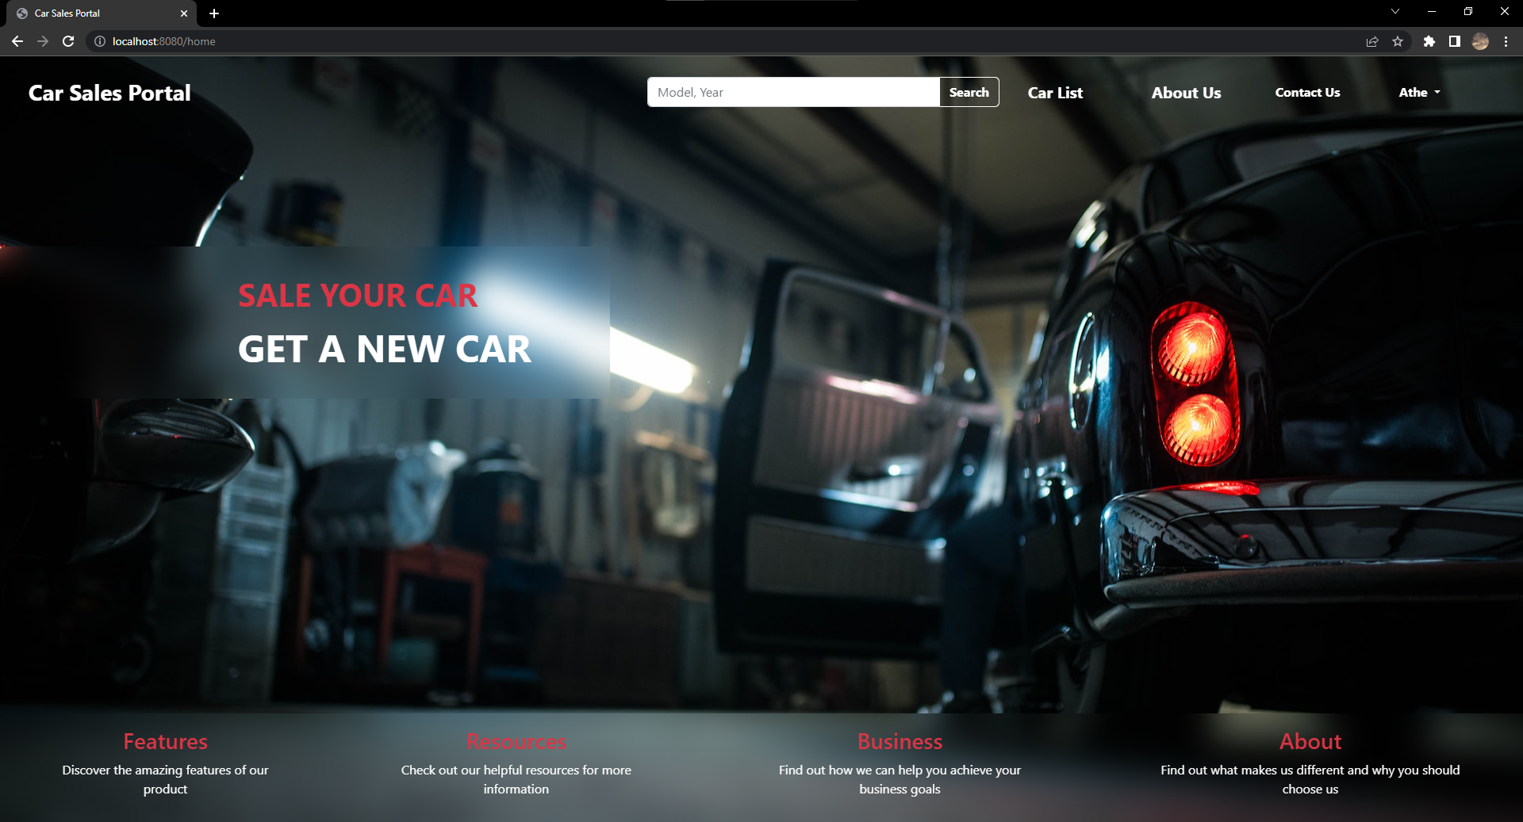
1. List of software used
Google Chrome

Slide 8
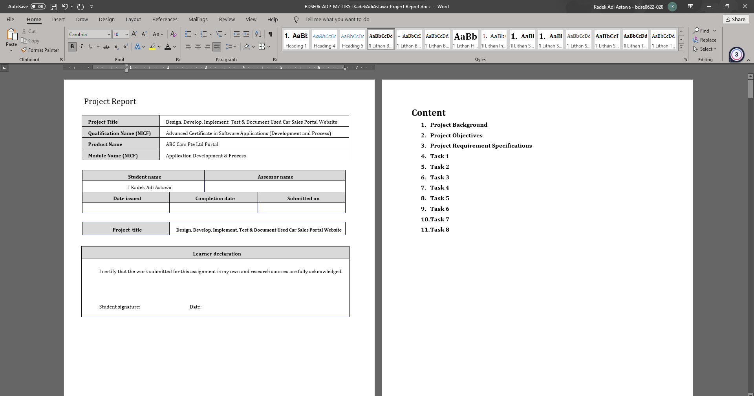
1. List of software used
Microsoft Word

Slide 9
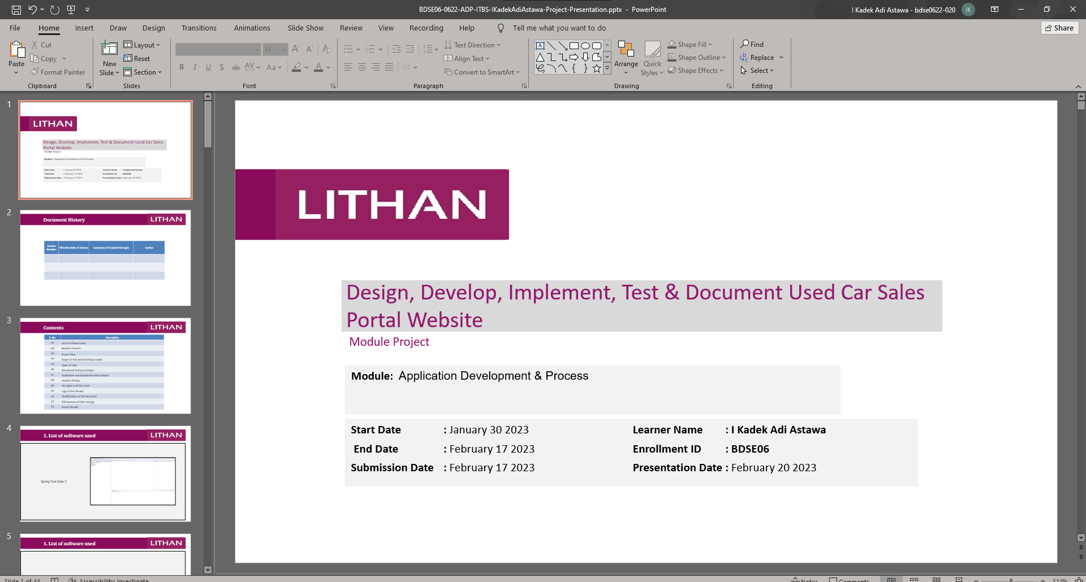
1. List of software used
Microsoft PowerPoint

Slide 10
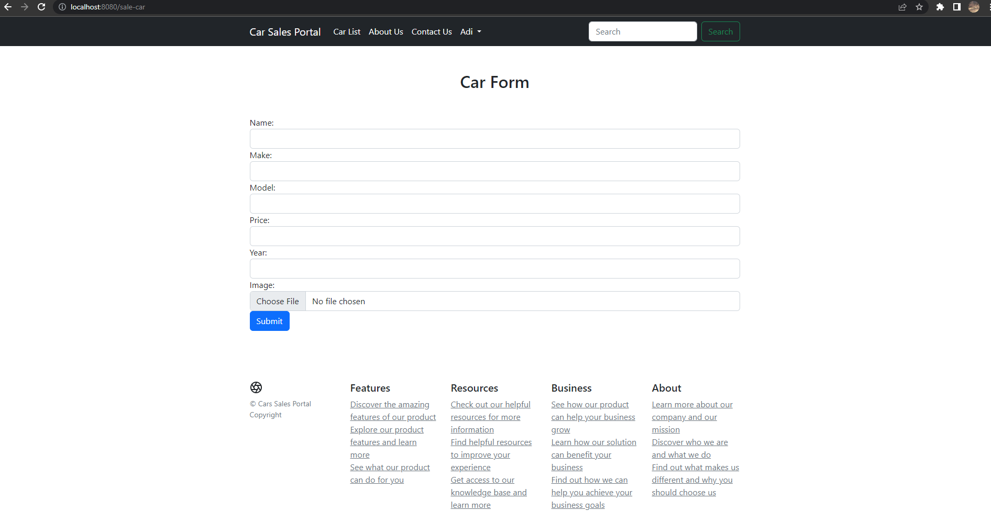
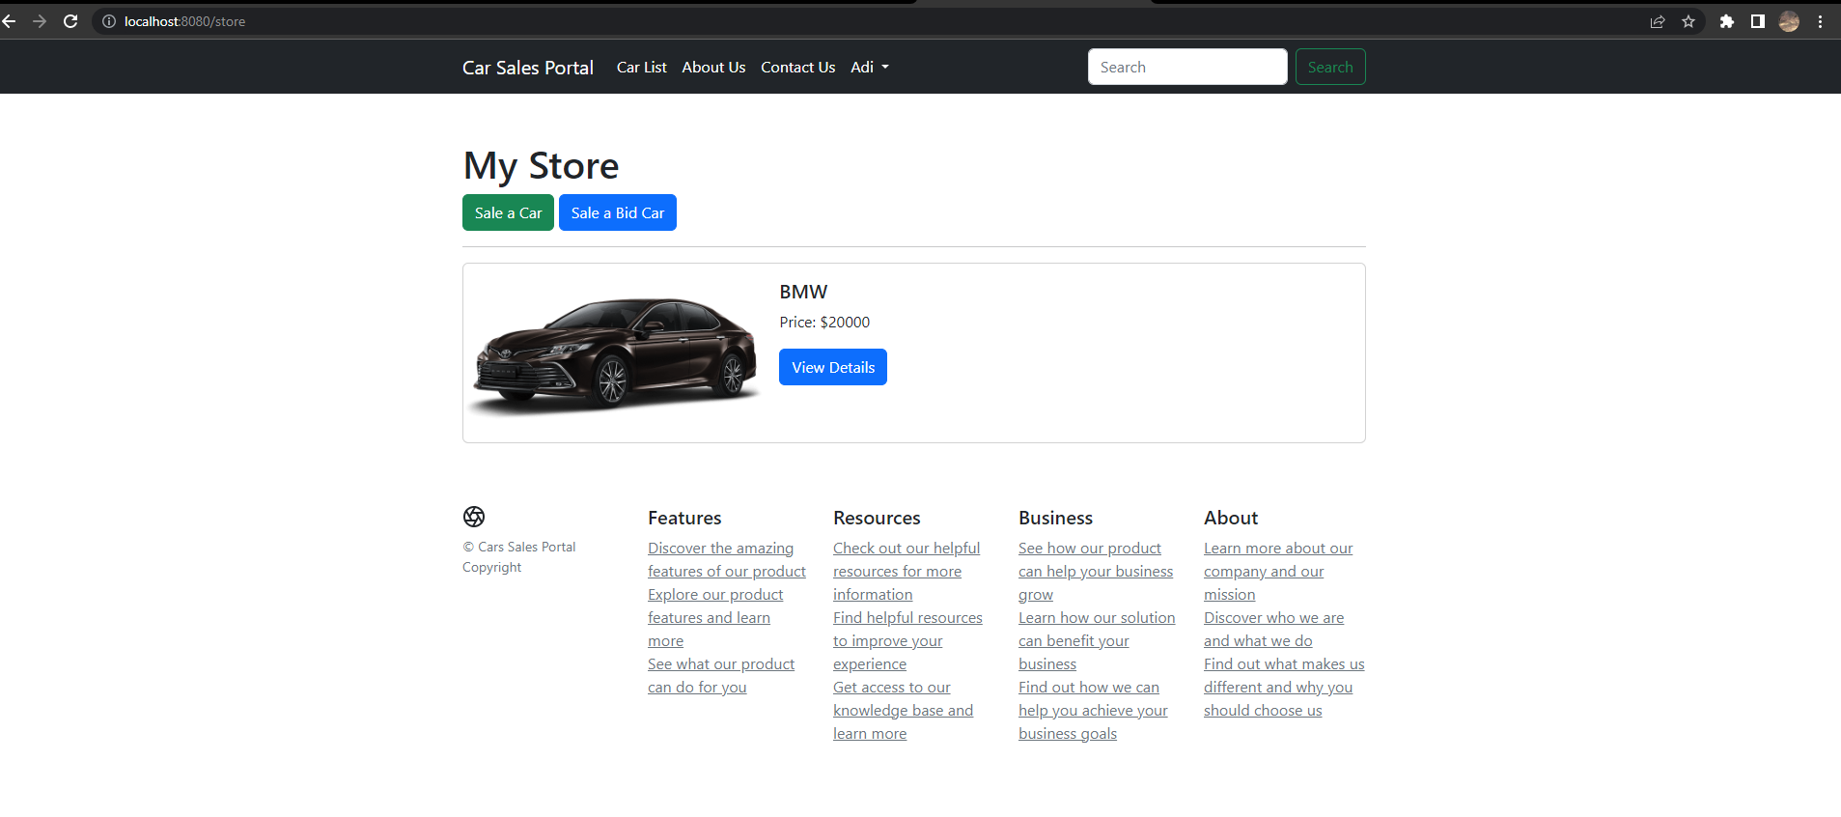
2. Business Process
Post Car Scenario
First user needs to log in to access the post car page, post car page is located on “ My Store Page ” and select if the car will be a bidding car or just a regular car. In the post car form, the user needs to fill in the form fit for the car criteria and click the post button.

Slide 11
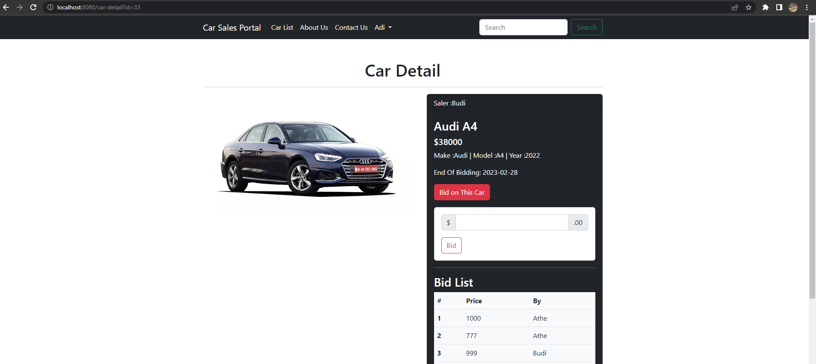
2. Business Process
Bidding a car
To bid on a car, the user must go to the auction page, and next to the "View Details" button is the "Bid This Car" button. Clicking this button will open a form for you to enter the amount you wish to bid on. To see a list of bidders for the same car, click the "View Details" button on the car map on the site and a list of bidders for that car will be displayed.

Slide 12
2. Business Process
Functionality of Scenarios
Pages | Functionality
My Store Page | To view all car you sell, and add new car
Post Car Page | To post a car
Bid Car Detail pape | To get car detail information and bid for a car

Slide 13
3. Project Plan
Phases | Activity | Start Date | End Date
Planning | Deciding the purpose and scope of this project. | 11 February 2023 | 11 February 2023
 | Analyze risks that may arise during the project.
 | Identify project requirements.
 | Decide the tool that will be used.
Risk Analysis | Analyze every risk that might happen in this project, and prioritize them based on their severity. | 11 February 2023 | 11 February 2023
 | Create a response plan for each risk, this plan should include how to handle the risk.
 | Monitoring the risk throughout the project. | 11 February 2023 | 17 February 2023
Development & Testing | Create a Prototype of a Cars Sales Portal. | 12 February 2023 | 12 February 2023
 | Create all the views and map them. | 13 February 2023 | 16 February 2023
 | Add spring security.
 | Do testing on the application. | 16 February 2023 | 16 February 2023
Evaluation | Assess the suitability of the website. | 17 February 2023 | 17 February 2023
 | Performance evaluation
 | Safety checking if the role system works or not.

Slide 14
4. Stages of Risk Based Testing model
Risk identification
In this stage, the project team needs to documenting potential risks that might impact the website.
Risk analysis
After the risk is identified, the project team needs to analyze the risk, by doing this the risk will be sorted based on its impact to the website, and it will be easy to prioritize the risk.
Test planning
In this stage, the project team needs to create a test plan that focus on the higher risk based on the risk that have been analyzed.
Test executing
During this stage project team will executing the test plan based on the highest failure risk.
Test reporting
After executing the test, team project need to create a report about the result of the test.

Slide 15
5. Types of risks
Type of risk | Risk identification | Risk description | Impact
Functional | Login risk | User cannot Login | If the user cannot login to the website, user cannot use many functionalities of the website like buying or selling their car, and the user might go to other website.
 | Register Risk | User cannot Register | The user wouldn’t have the account to login to the website.
 | Bidding Car Risk | User cannot bid on car | The user cannot join to bid on the car which mean they have no chance to get the car
 | Post Car Risk | User cannot post a car | The user’s car cannot be seen by another user that might want to buy the car.
 | Search Risk | User cannot search a car | Any specific car will get hard to find because the search bar is not working.
Non-Functional Risk | Performance | Car listing page is not load in expected time | The user go to other website because tired the loading take more time.
 | Compatibility | Css doesn’t loaded in several browsers | The user finds it strange and the website might become very different from what it expected.
 | Maintainability | The code is hard to read | Other developer want to add some feature but confuse where to put the code.
 | Usability | Hard to search for car be cause the position of the search form | User want to search a car but cannot find the search form, it took a while to find the search form.
Technical Risk | Security | Other than admin role can access administrator panel | All data on database might get deleted by random user.
 | Portability | The website isn’t responsive | Mobile user want to access the web but the web view become untidy.

Slide 16
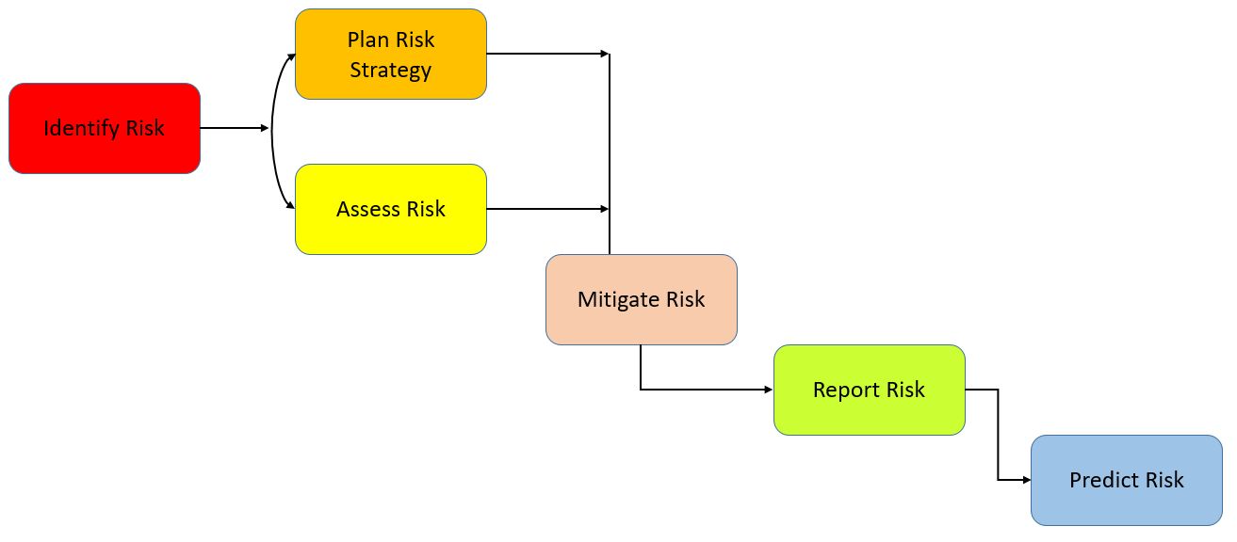
6. Risk Based Testing Strategies
Identify Risk
The first step is to indentify the potential risk that might happen in Cars Sales Portal. Common risk that potentially happen is security risk,funtional risk, usability risk,compatibility risk, and performance risk.
Plan Risk Strategy and Assess Risk
Once the risk identified the next step is to spell out risk likelihood and the impact and sort the by three categories High, medium, and Low.
Mitigate Risk
This step will procees to find out how to dealing with those risk.
Report Risk
This step will process to documenting each risk that have been found.
Predict Risk
In this step will procees to predicting a potential risk in future before the risk a threat.

Slide 17
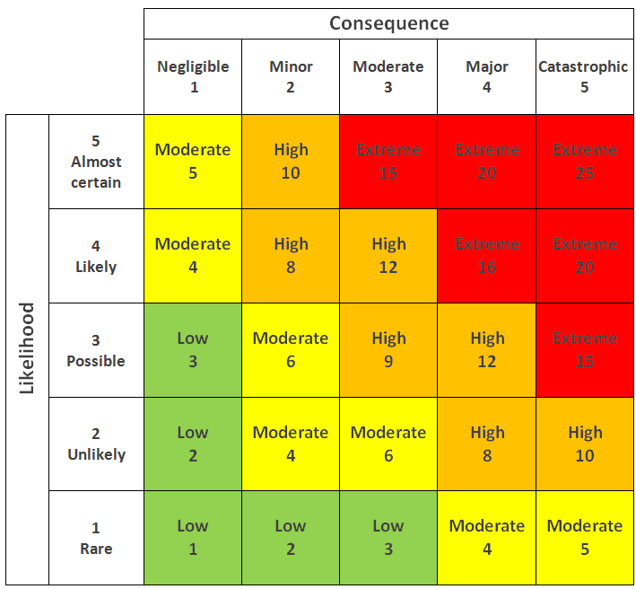
6. Risk Based Testing Strategies
Risk Matrix
Risk ID | Risk | Likelihood (1-5) | Impact (1 – 5) | Type of Testing | Risk Rating | Risk Level
1 | the data isn’t inserted to the database | 2 | 5 | Functional Testing | 10 | High
2 | The data isn’t updated in the database | 2 | 5 | Functional Testing | 10 | High
3 | User can’t see the page supposed to be | 2 | 3 | Functional Testing | 6 | Moderate
4 | User can’t see the car they want | 3 | 1 | Functional Testing | 3 | Low
5 | User can’t sale their car | 2 | 3 | Functional Testing | 6 | Moderate
6 | The website look different in other browser | 4 | 1 | Compatibility Testing | 4 | Moderate
7 | User wait longer | 3 | 3 | Performance Testing | 9 | High
8 | Miss communication between user and the website | 4 | 3 | Usability Testing | 12 | High
9 | Data loss | 5 | 5 | Security Testing | 25 | High
10 | The website cannot be accessed in different device | 4 | 3 | Portability Testing | 12 | High
11 | Hard to maintain the website | 2 | 1 | Maintainability testing | 2 | Low

Slide 18
7. Qualitative and Quantitative Risk Analysis
Qualitative Risk Analysis | Quantitative Risk Analysis
A risk analysis method that focuses on describing or qualifying potential risks and their impacts without using numerical measurements. | A risk analysis method that uses numerical data or quantitative measurements to calculate the likelihood and impact of a risk.
To identify potential risks and their impacts and provide recommendations for risk prevention or mitigation. | To assess the probability of a risk occurring and its impact on project objectives, to aid in decision-making.
Qualitative analysis can be conducted using techniques such as brainstorming, SWOT analysis, and risk matrices. | Quantitative analysis can be conducted using methods such as sensitivity analysis, Monte Carlo analysis, and simulation models.

Slide 19
8. Security Testing
Security Testing is a testing that focus on searching for a weakness of the system that might result a data loss from outsider.
Vulnerability Scanning : Is a process to find a vulnerability from security before it got founded by the attacker.
Security Scanning : Is a Process to scan a system network for vulnerabilities like open ports or outdated software.
Penetration Testing: Is a Simulation attack to the system to find a potential entry point that attacker could exploit.
Risk Assessment : identifying and evaluating potential risk to the system including technical and non-technical factor.
Security Auditing : is an internal inspection via line by line inspection of code for security law.
Posture Assessment : combination of ethical hacking and risk assessment.
Ethical Hacking : it’s an hacking organization that only exposing security flaw in the system.

Slide 20
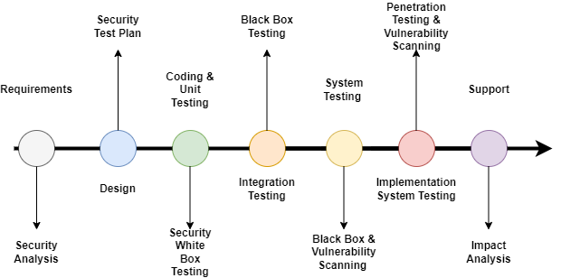
8. Security Testing
During the Requirement phase, security must analyze the requests and check for any abuse cases. During the Design Phase, security will analyze for the design. For Coding and Unit Testing Phase, use static, dynamic and white box testing. In the Integration Phase, the testing that will be used is black box testing. During the System Phase, black box testing and vulnerability scanning will be used. Penetration testing and vulnerability scanning will be used in Implementation System Phase. The final Phase is Support, analyzing the impact of patches.

Slide 21
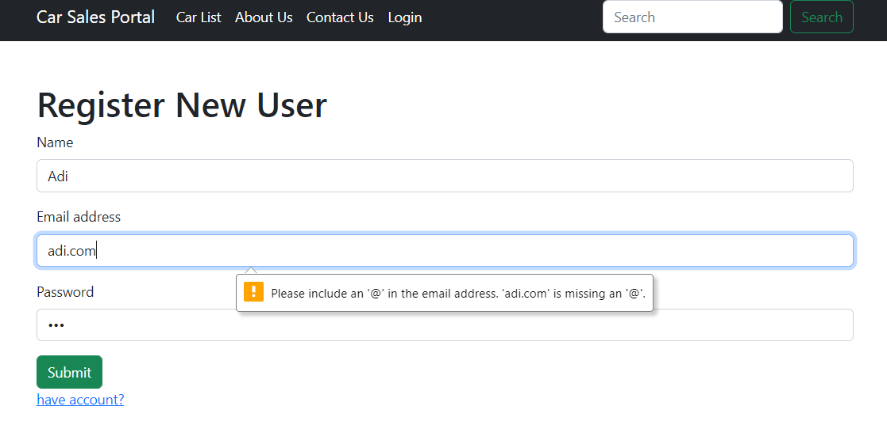
9. Test plans and Test cases
UAT Test
Registration
Test Scenario | Registration
TS001
Test Cases | Registration in Cars Sales Portal
TC001 | Validating data that has entered into registration page
TC002 | Once data has entered it should save the data into database
Test Scenario ID | Test Case ID | Test Priority | Pre-condition | Expected Result | Actual Result | Pass/ Fail
TS001 | TC001 | Moderate | Any user can access the website | A massage will appear when the input is wrong | The massage is appear | Pass
 | TC002 | High |  | The information that user put in the for inserted to the databae | The information is inserted to the database | Pass
Test Step & Test data | TC001 | In Registration Page, insert : 1. Name: Adi 2. Email: adi.com 3. Password: 123 6. Click Register button
 | TC002 | In Registration Page, insert : 1. Name: Adi 2. Email: adi@gmail.com 3. Password: 123 6. Click Register button

Slide 22
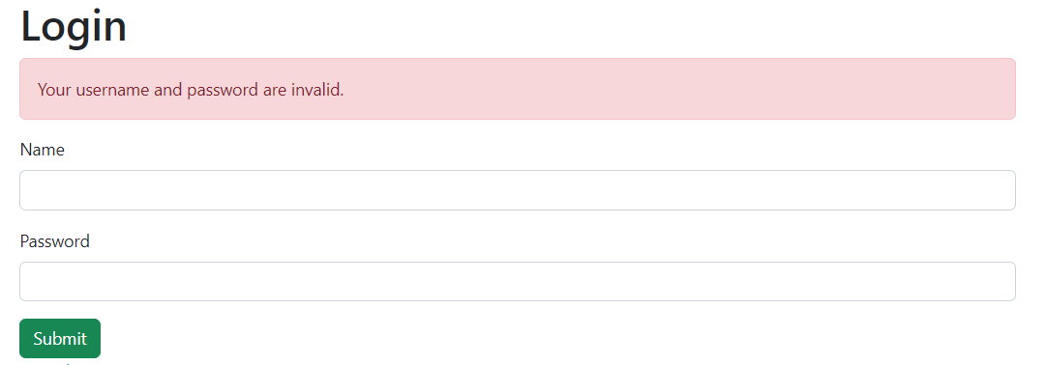
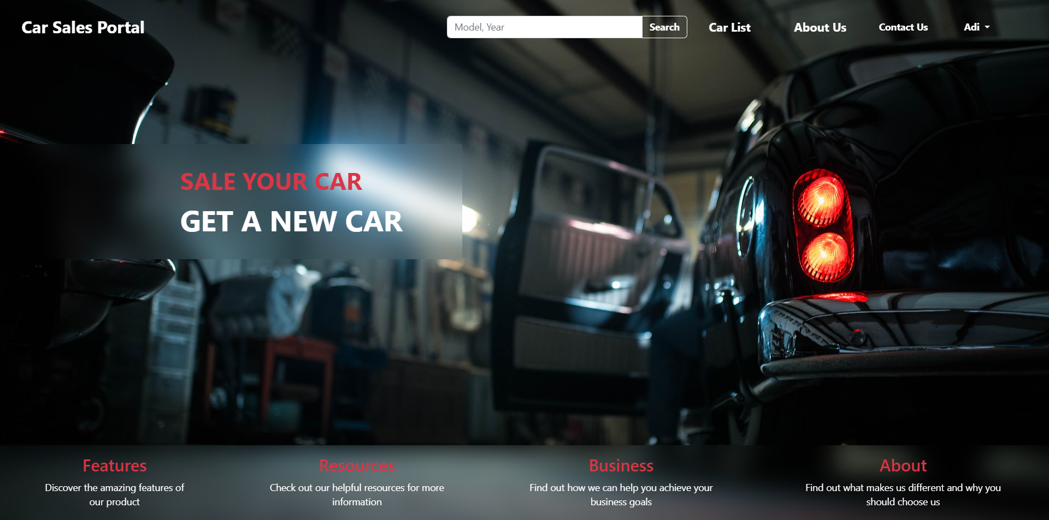
9. Test plans and Test cases
UAT Test
Login
Test Scenario | Login
TS002
Test Cases | Login in Cars Sales Portal
TC001 | User not found
TC002 | Once successfully login the name that display in the navbar should be the user currently login
Test Scenario ID | Test Case ID | Test Priority | Pre-condition | Expected Result | Actual Result | Pass/ Fail
TS002 | TC001 | Moderate | Any user can access the website | A massage will appear when the user is not found | The massage is appear | Pass
 | TC002 | Moderate | After successful login | User name will appear in the navbar | User name appear in the navbar | Pass
Test Step & Test data | TC001 | In the Login page, insert : 1.Name : Adi 2. Password : 122 3. Click Login
 | TC002 | In the Login page, insert : 1.Name : Adi 2. Password : 123 3. Click Login

Slide 23
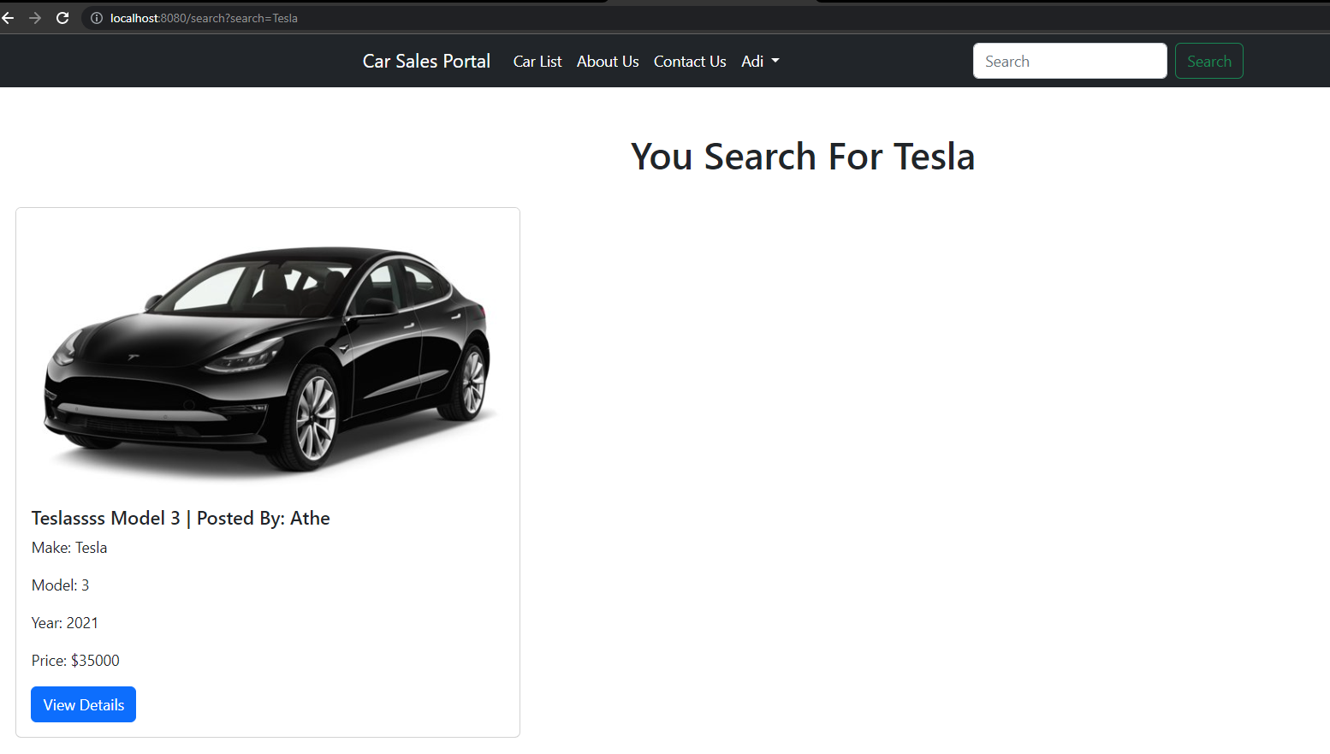
9. Test plans and Test cases
UAT Test
Search
Test Scenario | Search
TS003
Test Cases | Search Car in Cars Sales Portal
TC001 | Check if the page search form will go is Search Result page
TC002 | the car will display like what user type in the search input
Test Scenario ID | Test Case ID | Test Priority | Pre-condition | Expected Result | Actual Result | Pass/ Fail
TS003 | TC001 | Moderate | Any user can access the website | The form will go to search result page | The form action is going to search result page | Pass
 | TC002 | Moderate | Any user can access the website, the car what user search is exist | The car displayed like what user type | The displayed car is likely what user search for | Pass
Test Step & Test data | TC001 | In the search form, insert “Tesla” and click Search
 | TC002

Slide 24
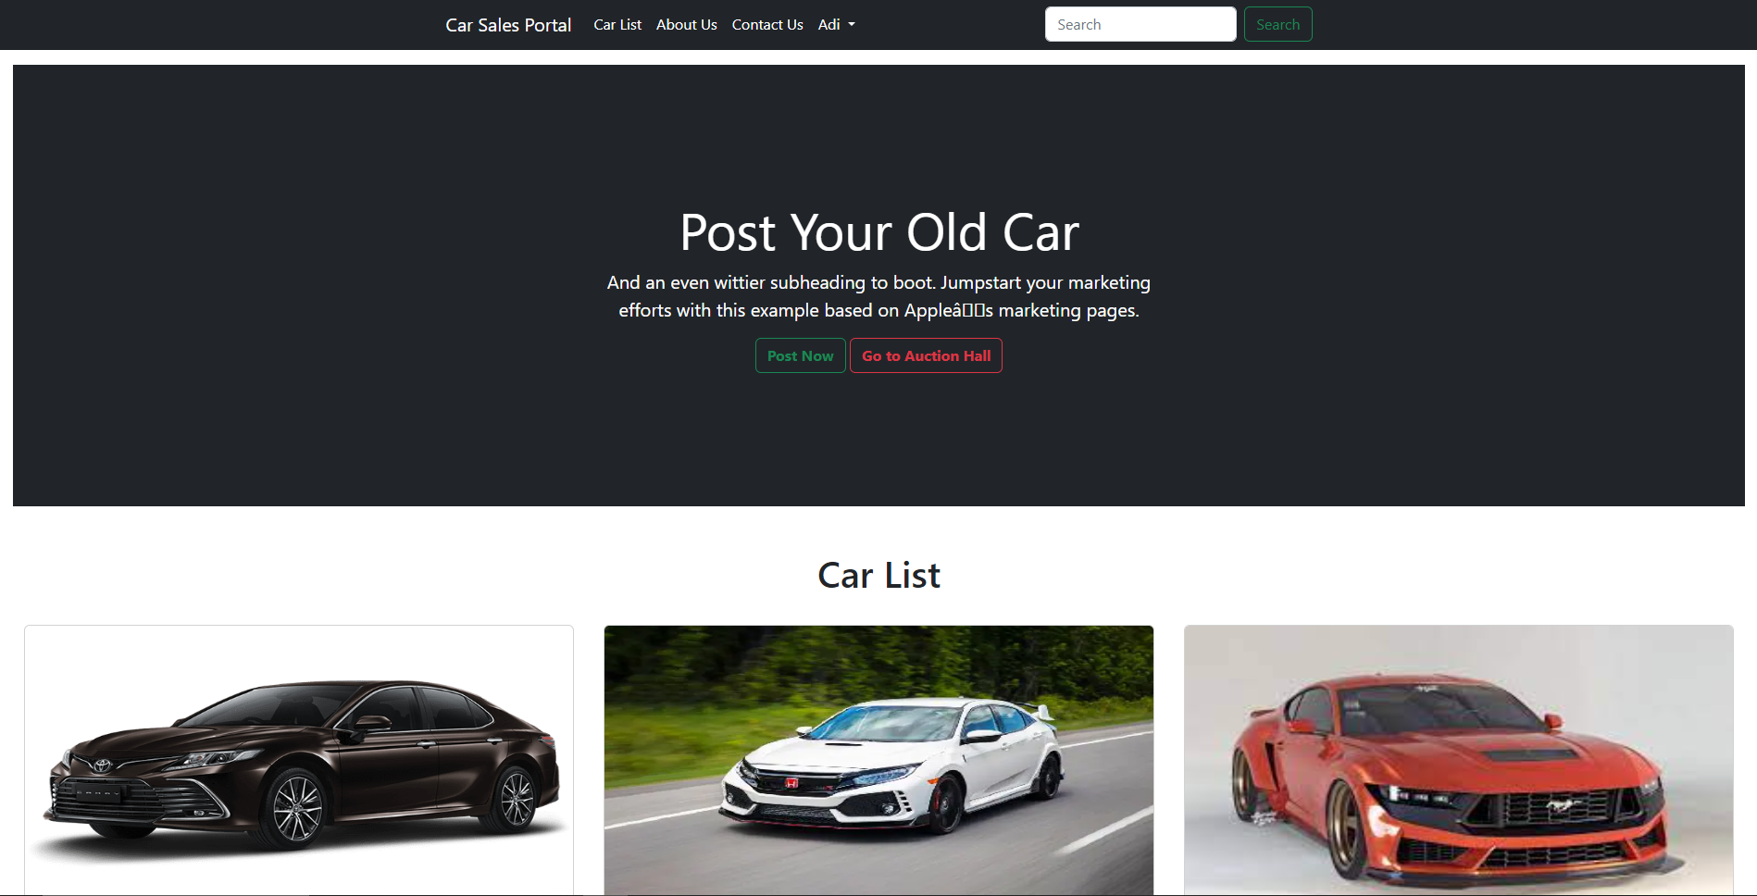
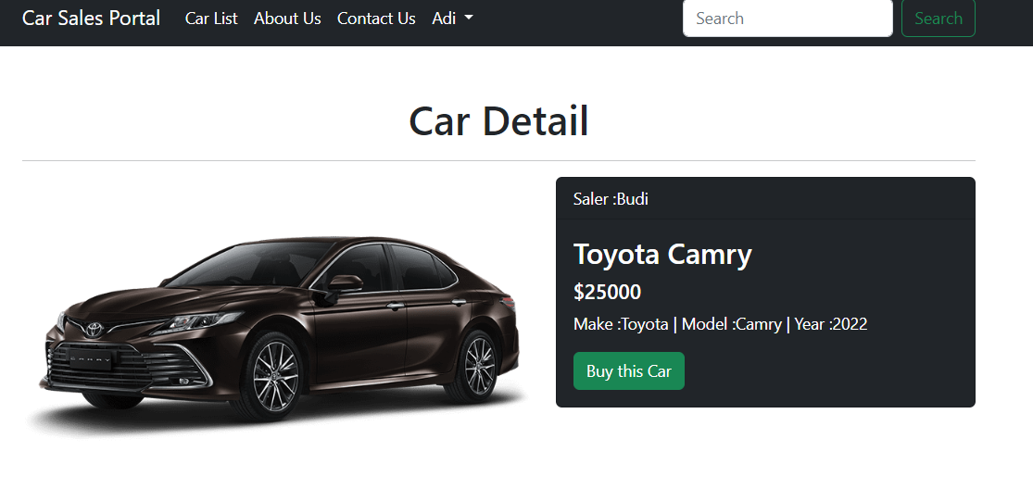
9. Test plans and Test cases
UAT Test
View All Car
Test Scenario | View Car
TS004
Test Cases | Display Car List in Cars Sales Portal
TC001 | Car List Page will display all car in database
TC002 | View detail button will display car detail information
Test Scenario ID | Test Case ID | Test Priority | Pre-condition | Expected Result | Actual Result | Pass/ Fail
TS004 | TC001 | Moderate | Any user can access the website, the car is exist | Carlist page will display every car in database | The page displaying all car | Pass
 | TC002 | Moderate | Any user can access the website, the car is exist | The view detail button will go to car detail page | The button action go to car detail page | Pass
Test Step & Test data | TC001 | In the home page click car list menu in navbar
 | TC002 | In the car list page click view detail button

Slide 25
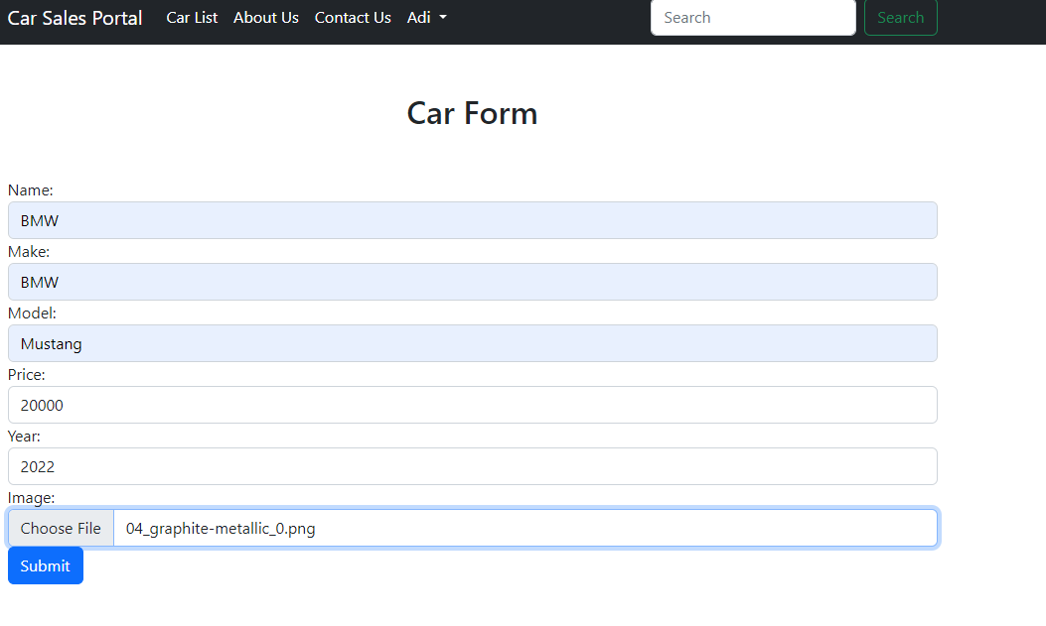
9. Test plans and Test cases
UAT Test
Post Car
Test Scenario | Post Car
TS005
Test Cases | Post a car in Cars Sales Portal
TC001 | The image when post a is stored in project directory
TC002 | The data of the car is stored in database
Test Scenario ID | Test Case ID | Test Priority | Pre-condition | Expected Result | Actual Result | Pass/ Fail
TS005 | TC001 | Moderate | User need to login | The image is stored in project directory | The image is stored in project directory | Pass
 | TC002 | High | User need to Log in | The data is stored in database | The data is stored in database | Pass
Test Step & Test data | TC001 | 1.Go to My Store Page 2.Click Sale a Car 3.Fill the form and select image 4.click submit
 | TC002

Slide 26
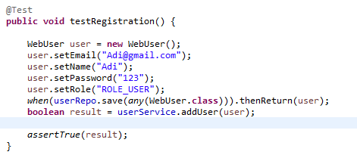
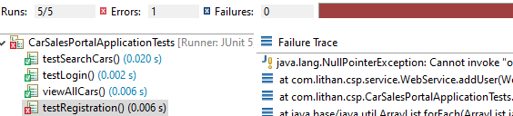
9. Test plans and Test cases
Unit Test
Registration
Test Scenario | Registration Page
TS006
Test Cases | Registration Functionality
TC001 | The data from registration form should be inserted to the database
Test Scenario ID | Test Case ID | Test Priority | Pre-condition | Expected Result | Actual Result | Pass/ Fail
TS006 | TC001 | High | Any user can access the website | The data should be inserted to the database | Something wrong with password encoder | Fail
Test Step & Test data | TC001 | 1.Create Registration Method 2.create new object user with user data inside of it. 3.use service to insert the data 4.run test cases

Slide 27
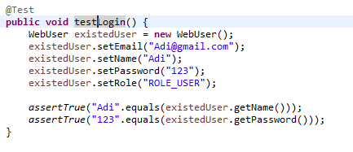
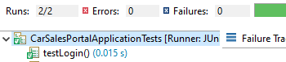
9. Test plans and Test cases
Unit Test
Login
Test Scenario | Login Page
TS007
Test Cases | Login Functionality
TC001 | Successfully Login
Test Scenario ID | Test Case ID | Test Priority | Pre-condition | Expected Result | Actual Result | Pass/ Fail
TS007 | TC001 | High | Any user can access the website | Success login using existing data from database | Success login using existing data | pass
Test Step & Test data | TC001 | 1.Create Login Method 2.create new object user with existed user data inside of it. 3.use service to check user data 4.run test cases

Slide 28
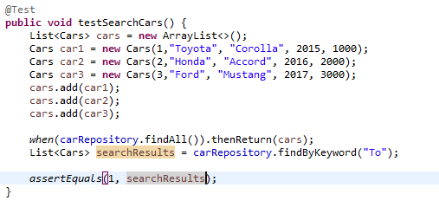
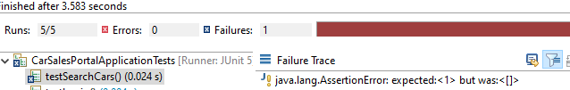
9. Test plans and Test cases
Unit Test
Search
Test Scenario | Search Page
TS008
Test Cases | Search Functionality
TC001 | Search for a Car
Test Scenario ID | Test Case ID | Test Priority | Pre-condition | Expected Result | Actual Result | Pass/ Fail
TS008 | TC001 | Moderate | Any user can access the website | Display the searched car | Car not founded | Fail
Test Step & Test data | TC001 | 1.Create Search Method 2.create new object car. 3.use service to search car. 4.run test cases

Slide 29
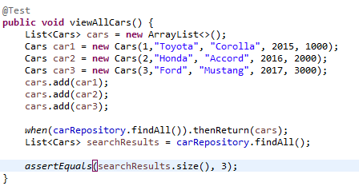
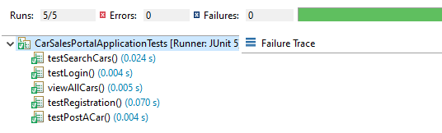
9. Test plans and Test cases
Unit Test
View All Car
Test Scenario | View Car Page
TS009
Test Cases | View Car Functionality
TC001 | Display
Test Scenario ID | Test Case ID | Test Priority | Pre-condition | Expected Result | Actual Result | Pass/ Fail
TS009 | TC001 | Moderate | Any user can access the website | List of car appear | List of car appear | Pass
Test Step & Test data | TC001 | 1.Create View Car Method 2.create new list of object with car data inside of it. 3.use service to display them all 4.run test cases

Slide 30
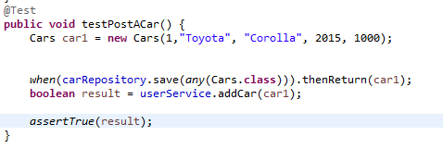
9. Test plans and Test cases
Unit Test
Post a Car
Test Scenario | Post Car
TS010
Test Cases | Post Functionality
TC001 | Post a car
Test Scenario ID | Test Case ID | Test Priority | Pre-condition | Expected Result | Actual Result | Pass/ Fail
TS010 | TC001 | High | Login using account that have user role | Car data got inserted to database | Car data got inserted to database | Pass
Test Step & Test data | TC001 | 1.Create post car Method 2.create new car object and give some value. 3.use service to insert the data 4.run test cases

Slide 31
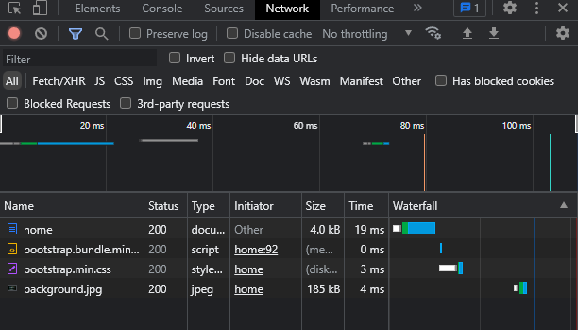
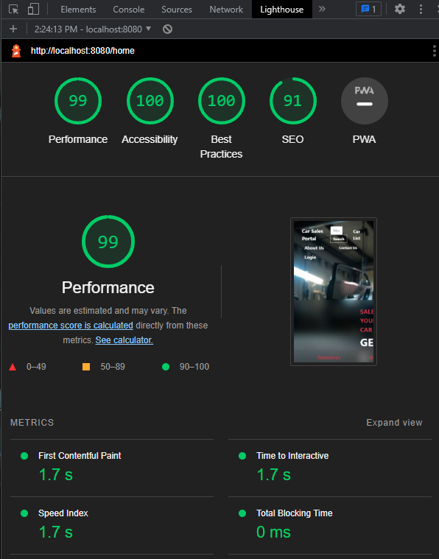
9. Test plans and Test cases
Performance Test
Test Scenario | Performance Test
TS011
Test Cases | Load test of Cars Sales Portal
TC001 | Test Case Speed
TC002 | Website Performace
Test Scenario ID | Test Case ID | Test Priority | Pre-condition | Expected Result | Actual Result | Pass/ Fail
TS011 | TC001 | Moderate | The website is published | The page load below 2 second | The page speed is 30 ms | Pass
 | TC002 |  |  | The performace should be above 80 | The performance is 99
Test Step & Test data | TC001 | Right click on the website > click network
 | TC002 | Right click on the website > click lighthouse > analyze page load

Slide 32
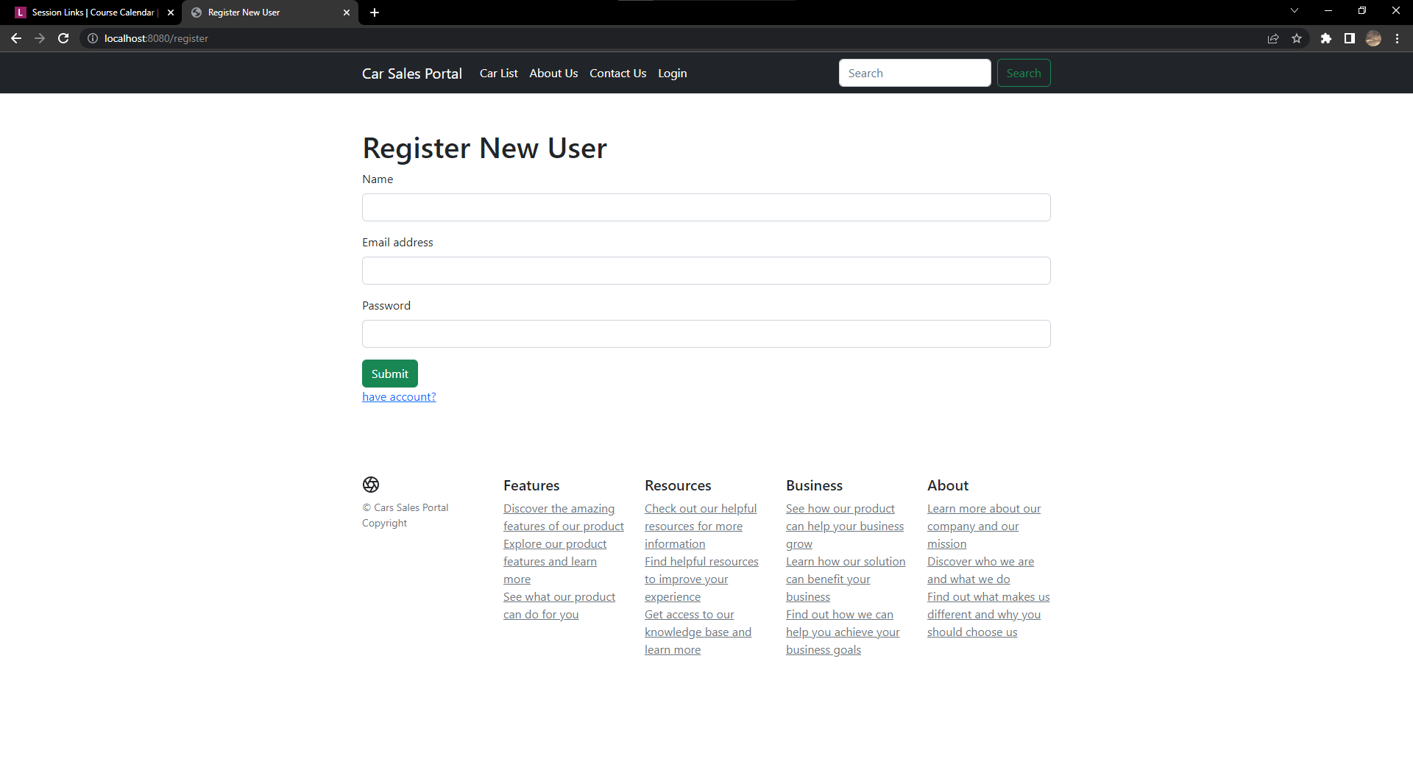
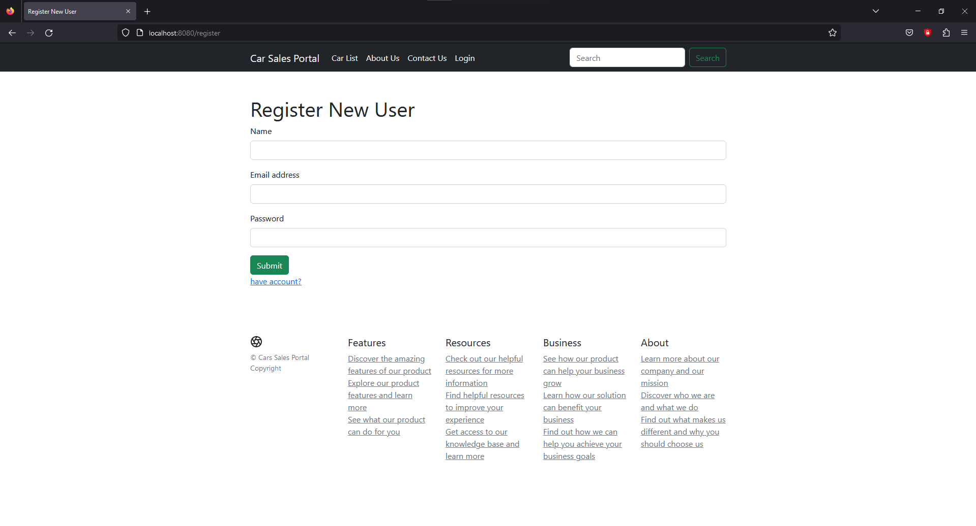
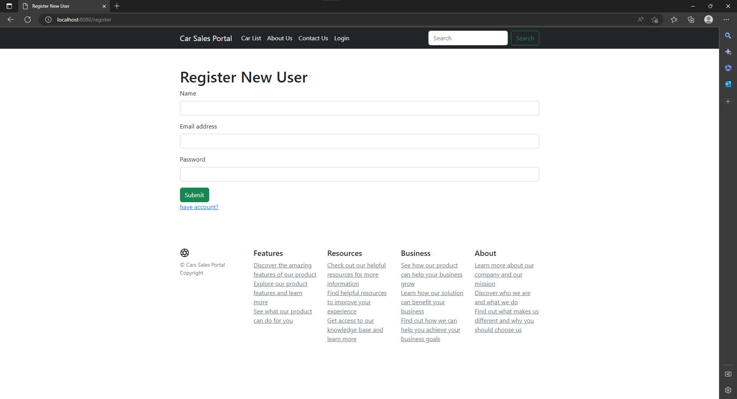
9. Test plans and Test cases
Compatibility Test
Register
Test Scenario ID | Test Case ID | Test Priority | Pre-condition | Expected Result | Actual Result | Pass/ Fail
TS012 | TC001 | Low | The website is published | The view is same in every browser | They look the same | Pass
 | TC002
 | TC003
Test Step & Test data | TC001 | Access localhost:8080/register in Chrome
 | TC002 | Access localhost:8080/register in Firefox
 | TC003 | Access localhost:8080/register in Microsoft Edge
Test Scenario | Cross browser register test
TS012
Test Cases | Register in Cars Sales Portal in three browser
TC001 | Run Cars Sales Portal in Chrome
TC002 | Run Cars Sales Portal in Firefox
TC003 | Run Cars Sales Portal in Microsoft Edge

Slide 33
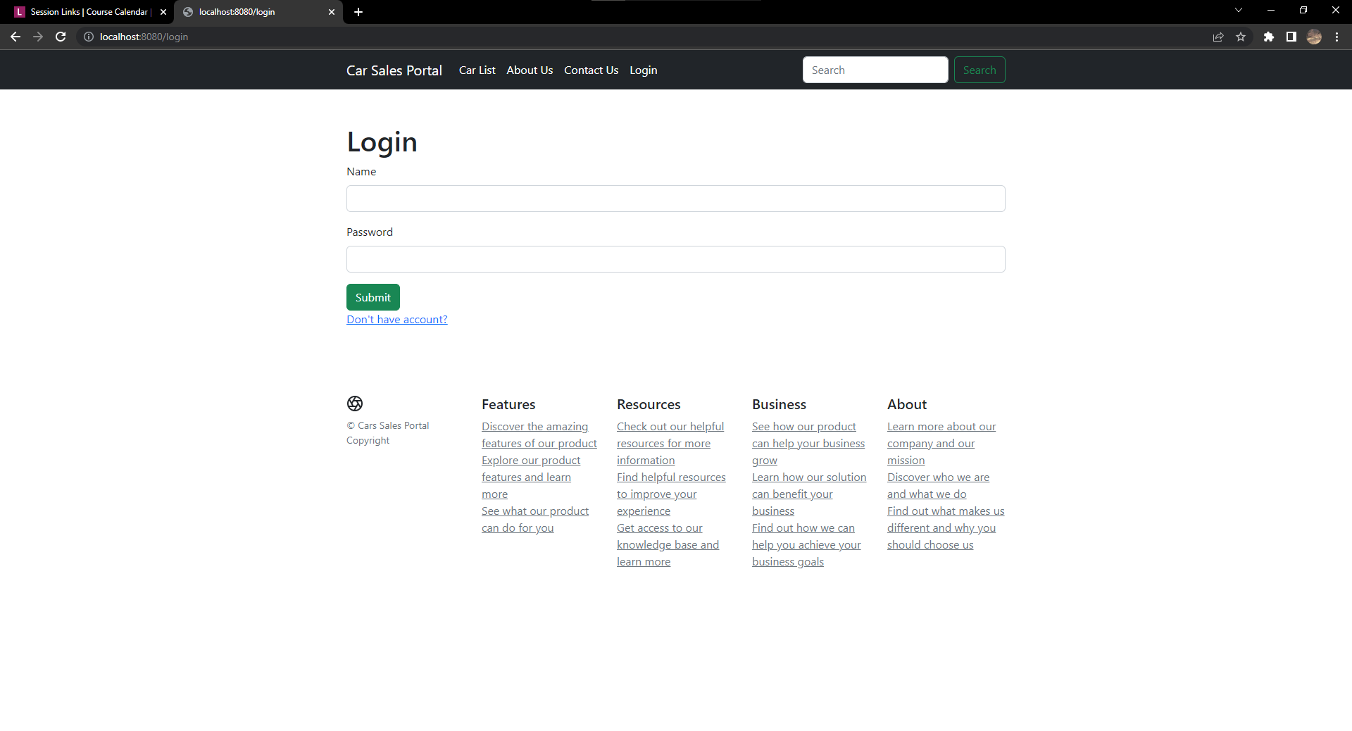
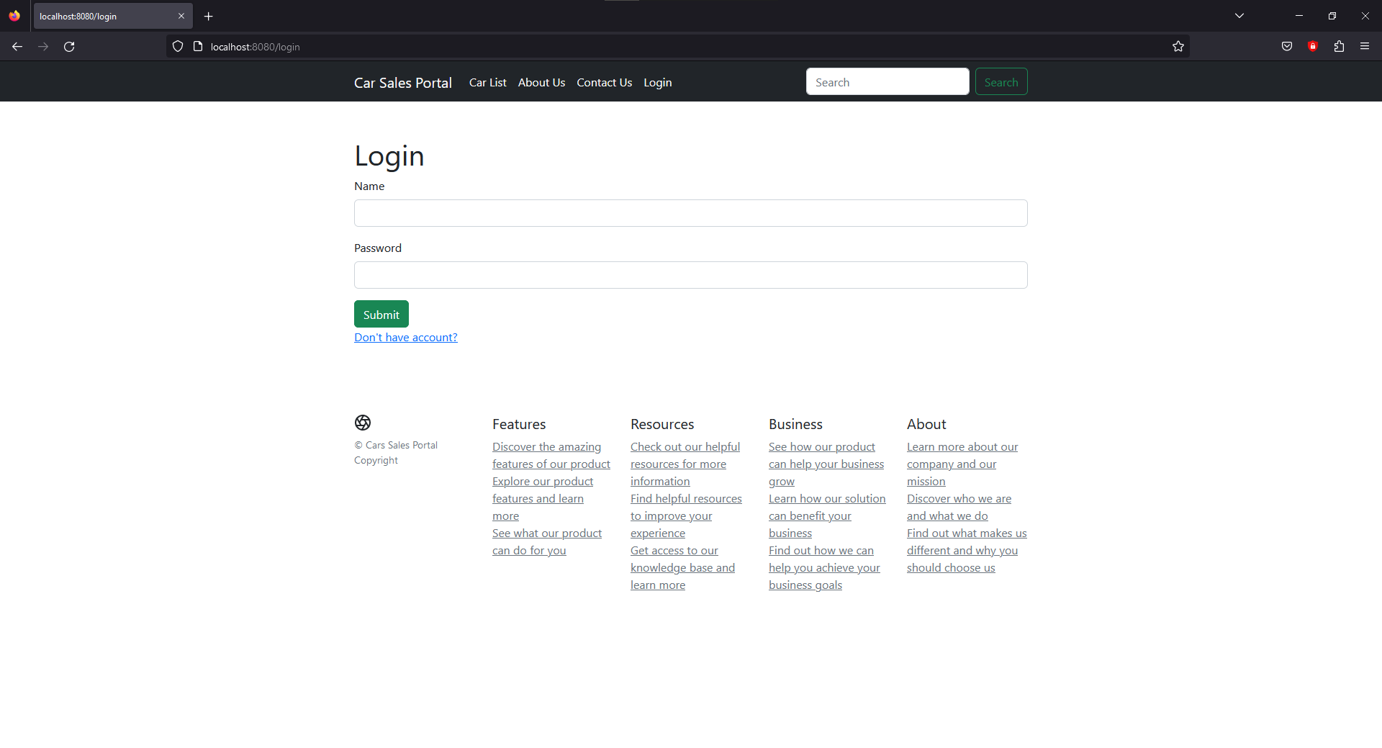
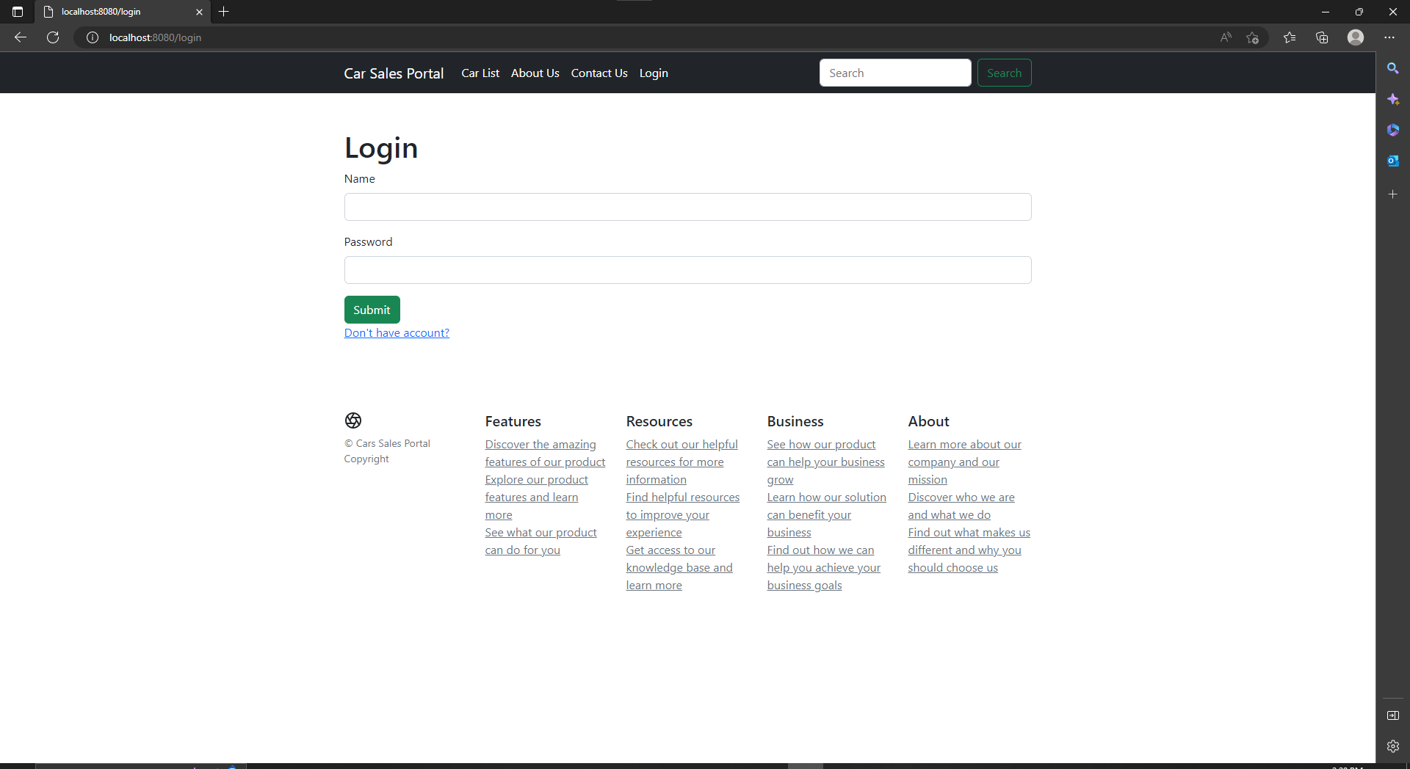
9. Test plans and Test cases
Compatibility Test
Login
Test Scenario ID | Test Case ID | Test Priority | Pre-condition | Expected Result | Actual Result | Pass/ Fail
TS013 | TC001 | Low | The website is published | The view is same in every browser | They look the same | Pass
 | TC002
 | TC003
Test Step & Test data | TC001 | Access localhost:8080/login in Chrome
 | TC002 | Access localhost:8080/login in Firefox
 | TC003 | Access localhost:8080/login in Microsoft Edge
Test Scenario | Cross browser login test
TS013
Test Cases | Login in Cars Sales Portal in three browser
TC001 | Run Cars Sales Portal in Chrome
TC002 | Run Cars Sales Portal in Firefox
TC003 | Run Cars Sales Portal in Microsoft Edge

Slide 34
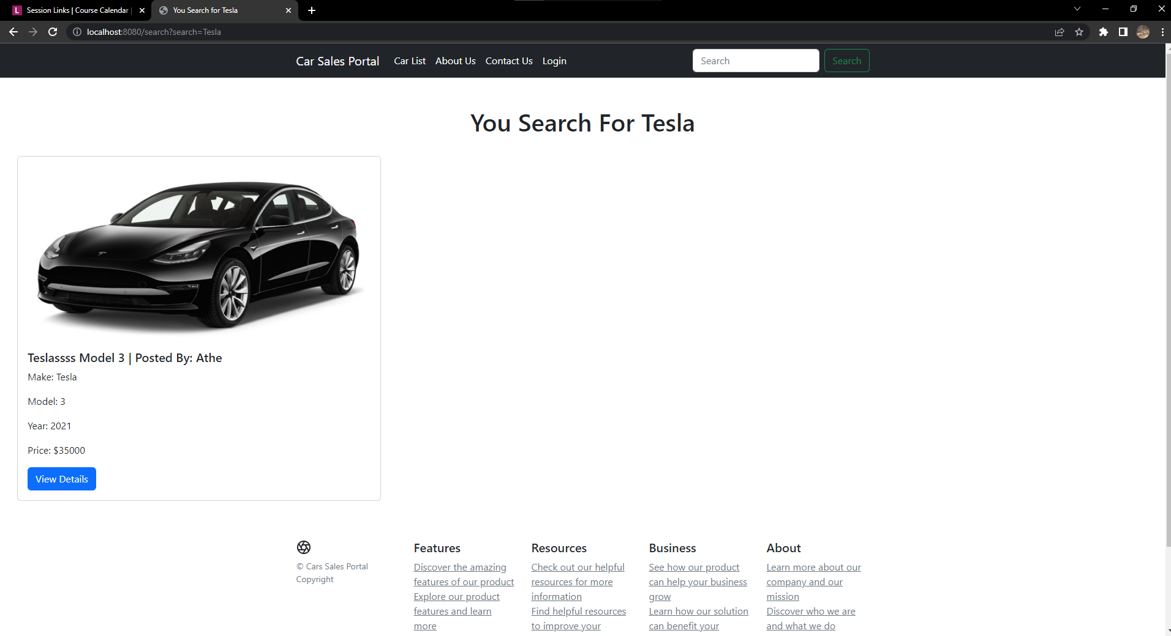
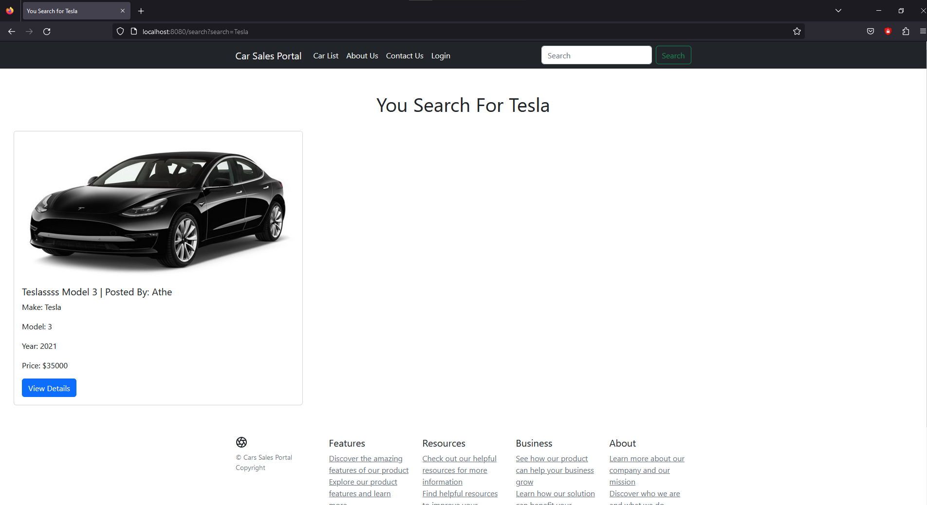
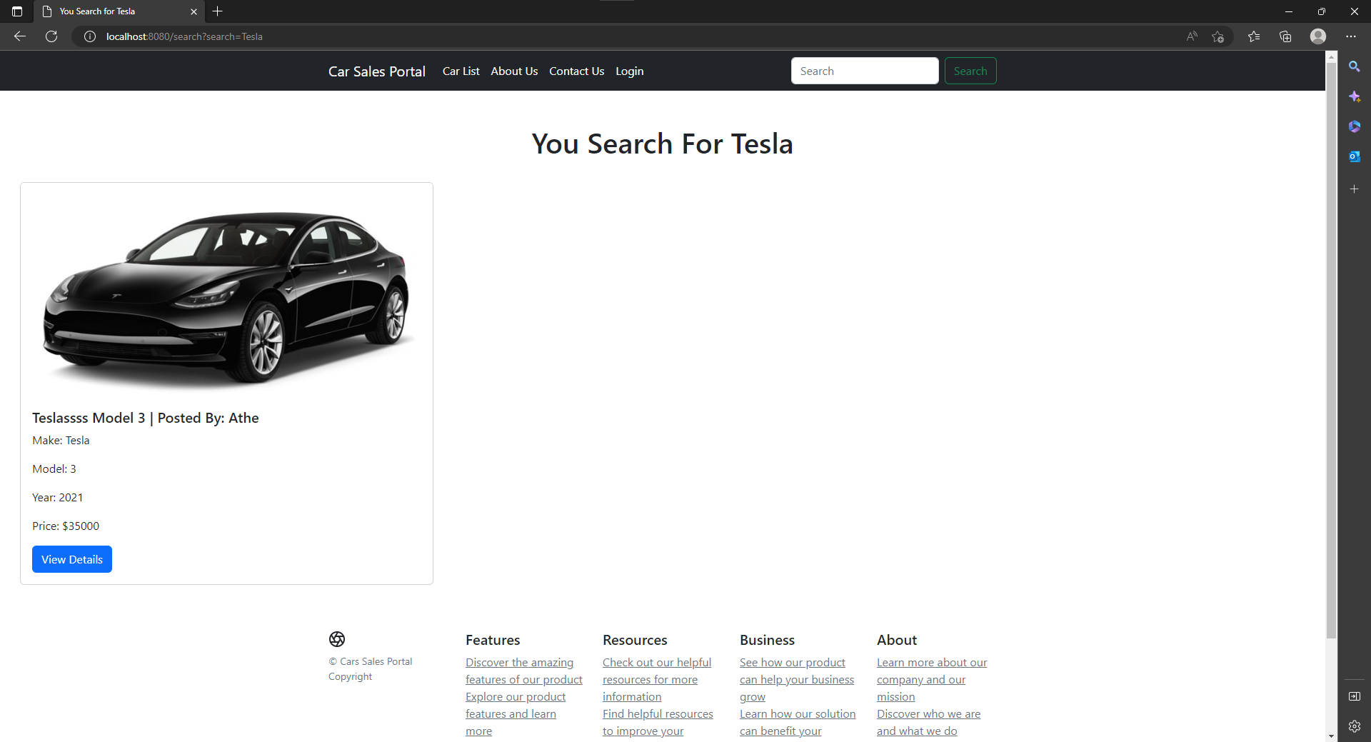
9. Test plans and Test cases
Compatibility Test
Search
Test Scenario ID | Test Case ID | Test Priority | Pre-condition | Expected Result | Actual Result | Pass/ Fail
TS014 | TC001 | Low | The website is published | The view is same in every browser | They look the same | Pass
 | TC002
 | TC003
Test Step & Test data | TC001 | Type car’s make or model in search form
 | TC002
 | TC003
Test Scenario | Cross browser search test
TS014
Test Cases | Use search in Cars Sales Portal in three browser
TC001 | Run Cars Sales Portal in Chrome
TC002 | Run Cars Sales Portal in Firefox
TC003 | Run Cars Sales Portal in Microsoft Edge

Slide 35
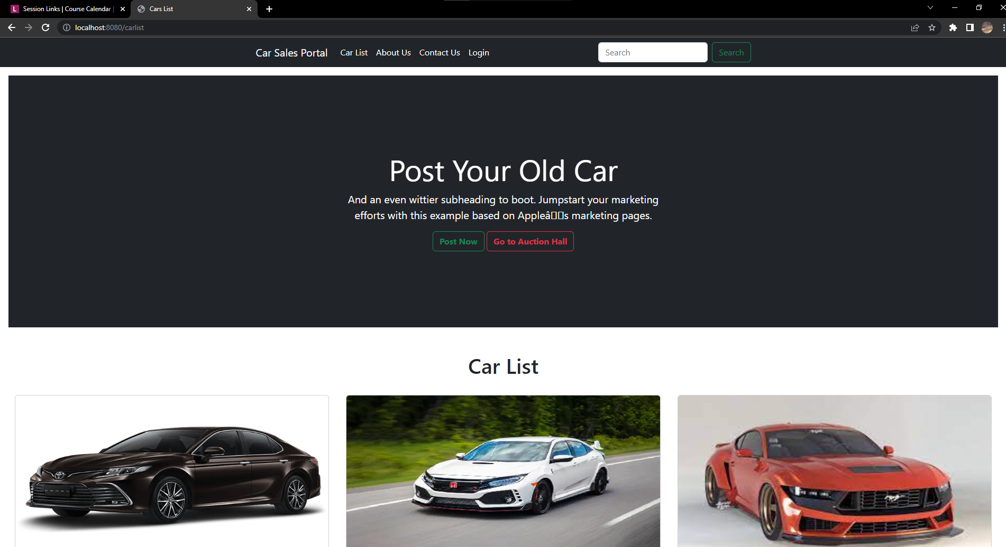
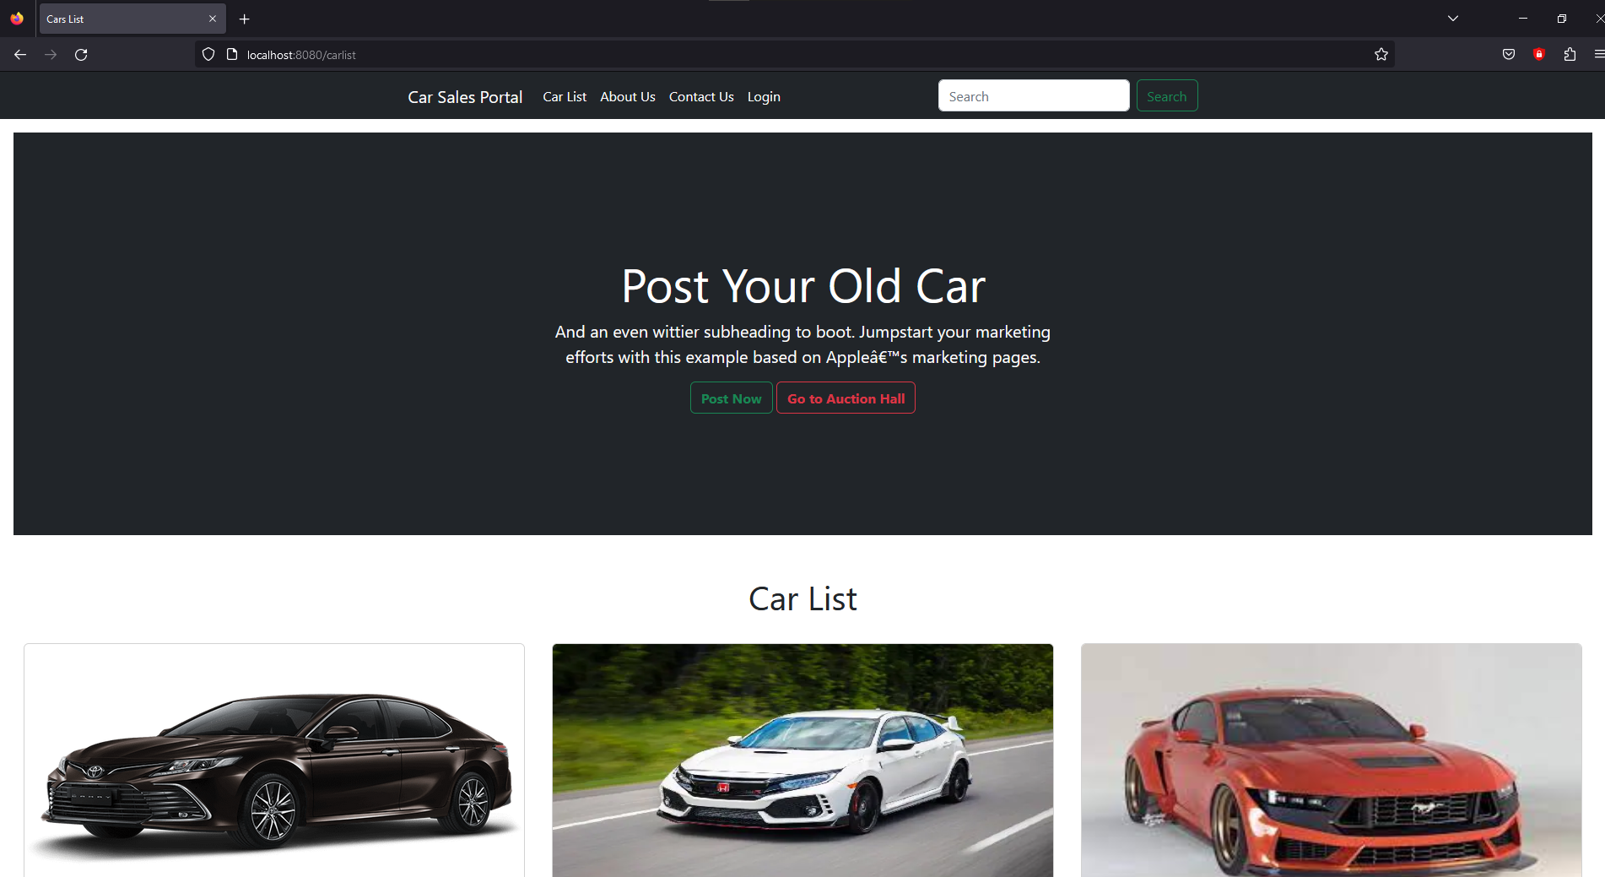
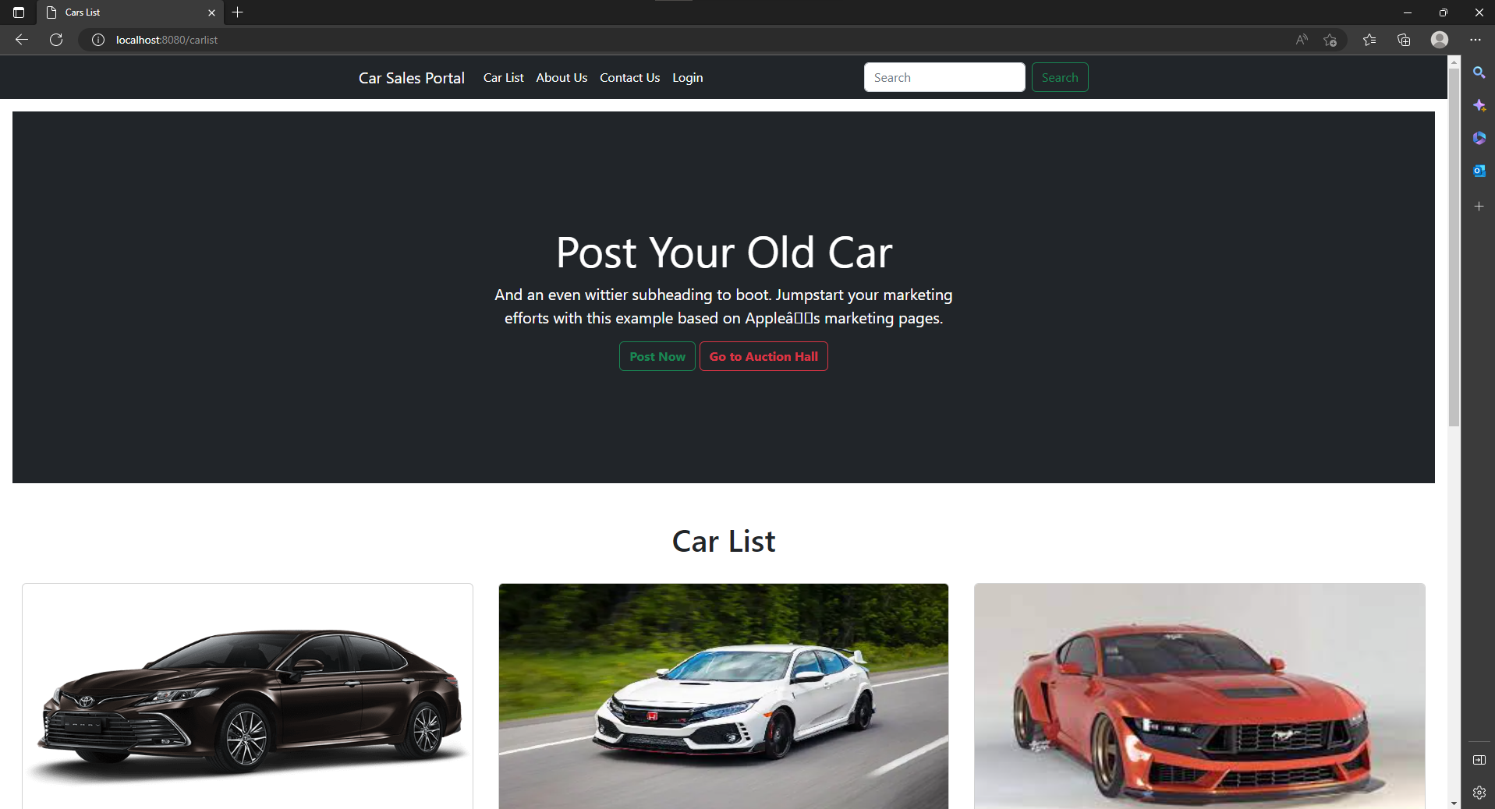
9. Test plans and Test cases
Compatibility Test
View all car
Test Scenario ID | Test Case ID | Test Priority | Pre-condition | Expected Result | Actual Result | Pass/ Fail
TS015 | TC001 | Low | The website is published | The view is same in every browser | They look the same | Pass
 | TC002
 | TC003
Test Step & Test data | TC001 | Access localhost:8080/carlist in Chrome
 | TC002 | Access localhost:8080/carlist in Firefox
 | TC003 | Access localhost:8080/carlist in Microsoft Edge
Test Scenario | Cross browser Car listing test
TS015
Test Cases | Display cars list in Cars Sales Portal in three browser
TC001 | Run Cars Sales Portal in Chrome
TC002 | Run Cars Sales Portal in Firefox
TC003 | Run Cars Sales Portal in Microsoft Edge

Slide 36
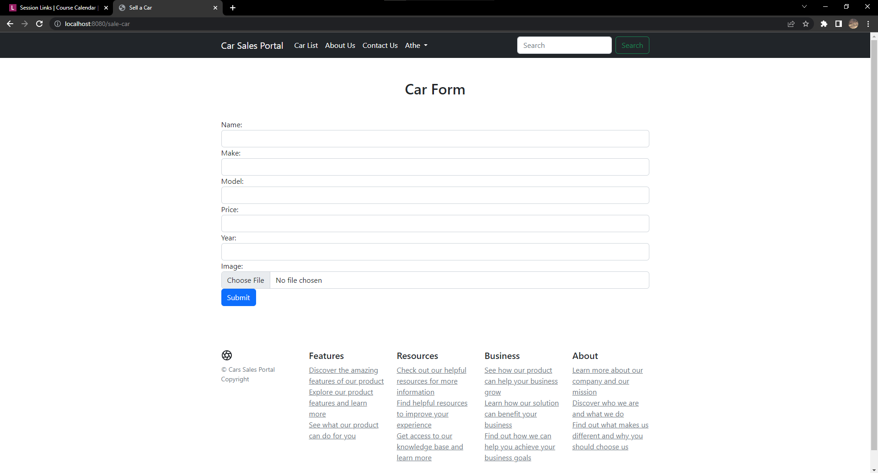
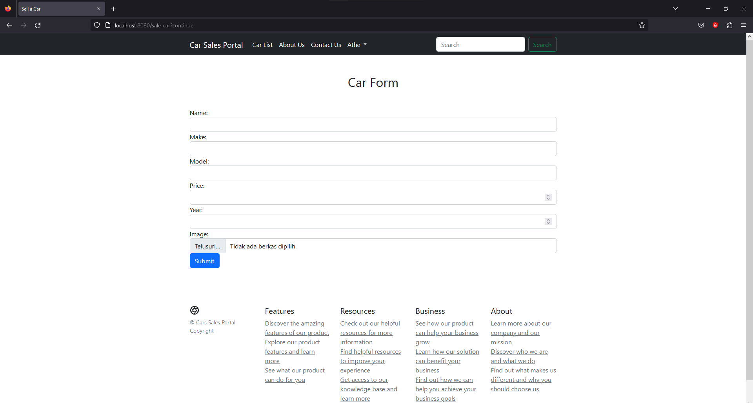
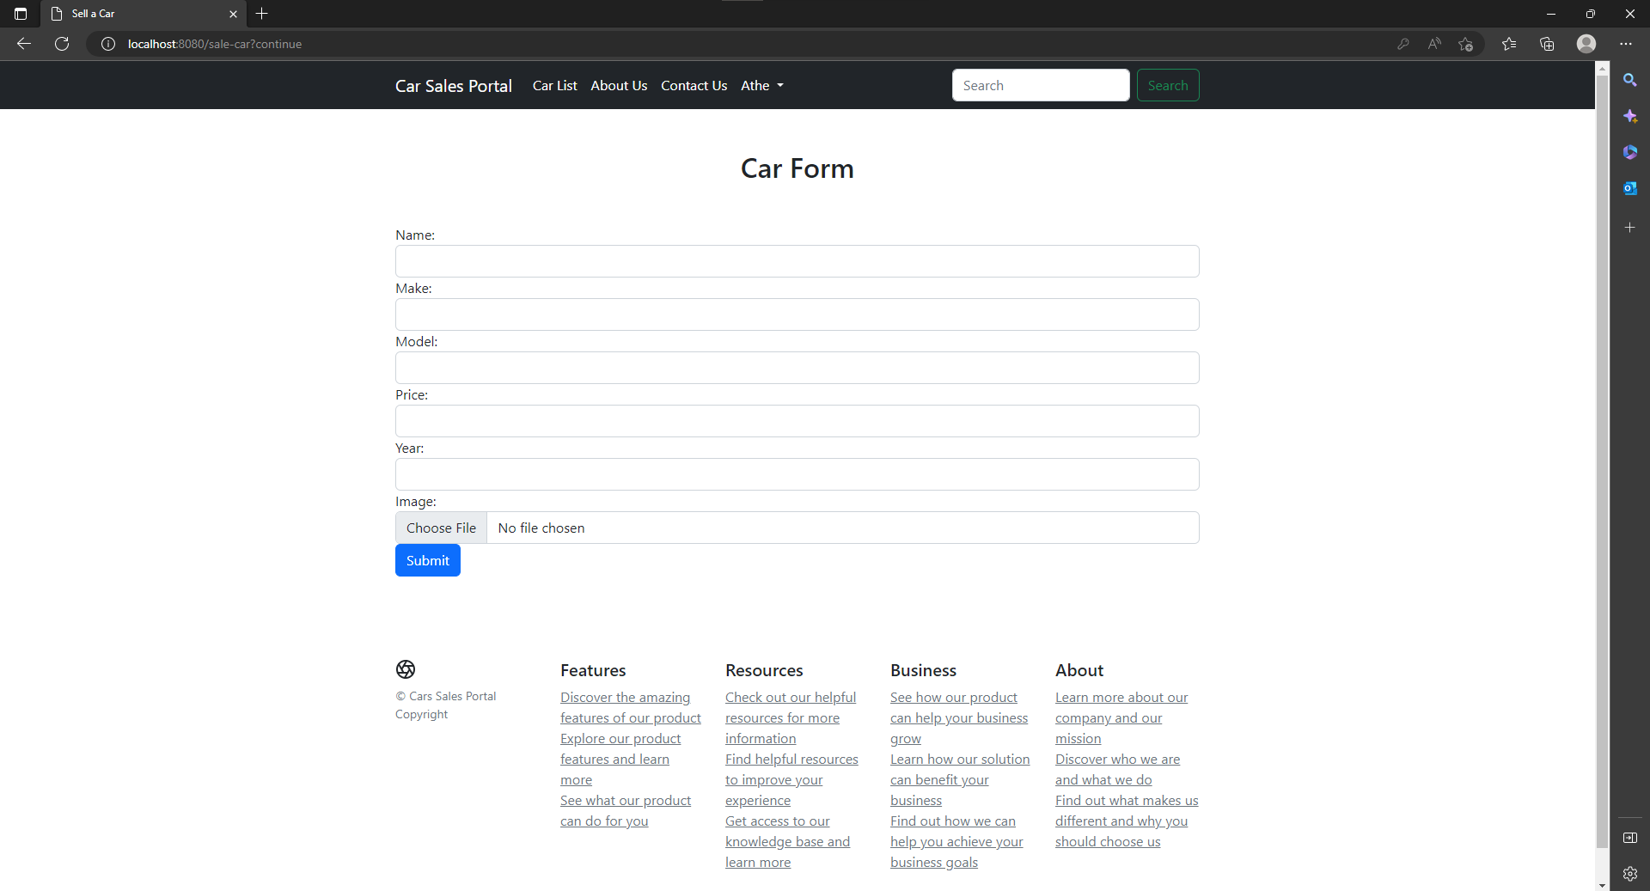
9. Test plans and Test cases
Compatibility Test
Post a car
Test Scenario ID | Test Case ID | Test Priority | Pre-condition | Expected Result | Actual Result | Pass/ Fail
TS016 | TC001 | Low | The website is published | The view is same in every browser | They look the same | Pass
 | TC002
 | TC003
Test Step & Test data | TC001 | Log in using user role account, click Sale car button or sale bid car button in my store page, fill the form and click submit.
 | TC002
 | TC003
Test Scenario | Cross browser post car test
TS016
Test Cases | Post a car in Cars Sales Portal in three browser
TC001 | Run Cars Sales Portal in Chrome
TC002 | Run Cars Sales Portal in Firefox
TC003 | Run Cars Sales Portal in Microsoft Edge

Slide 37
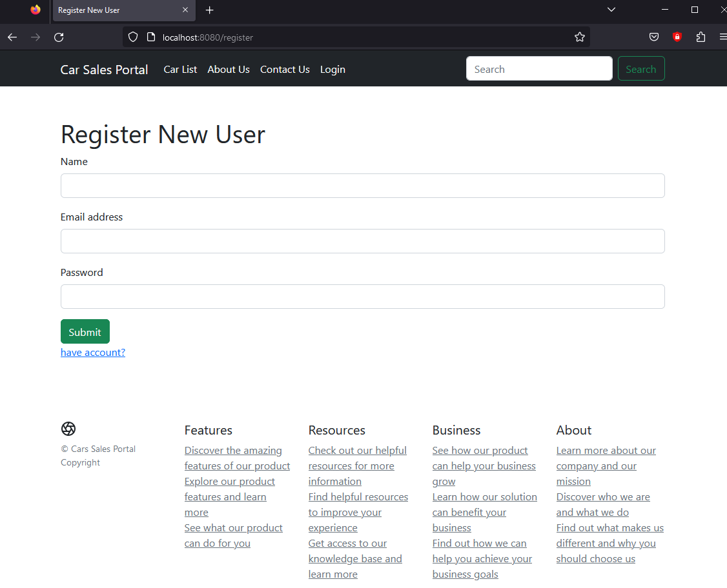
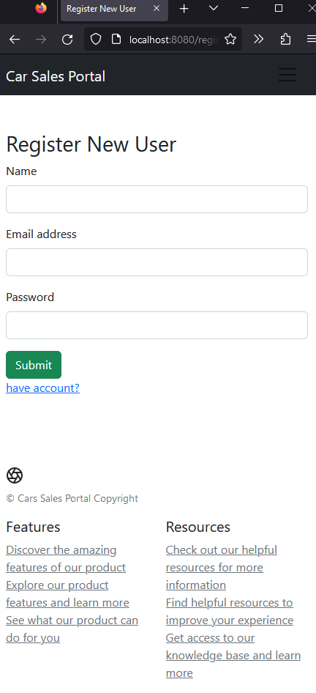
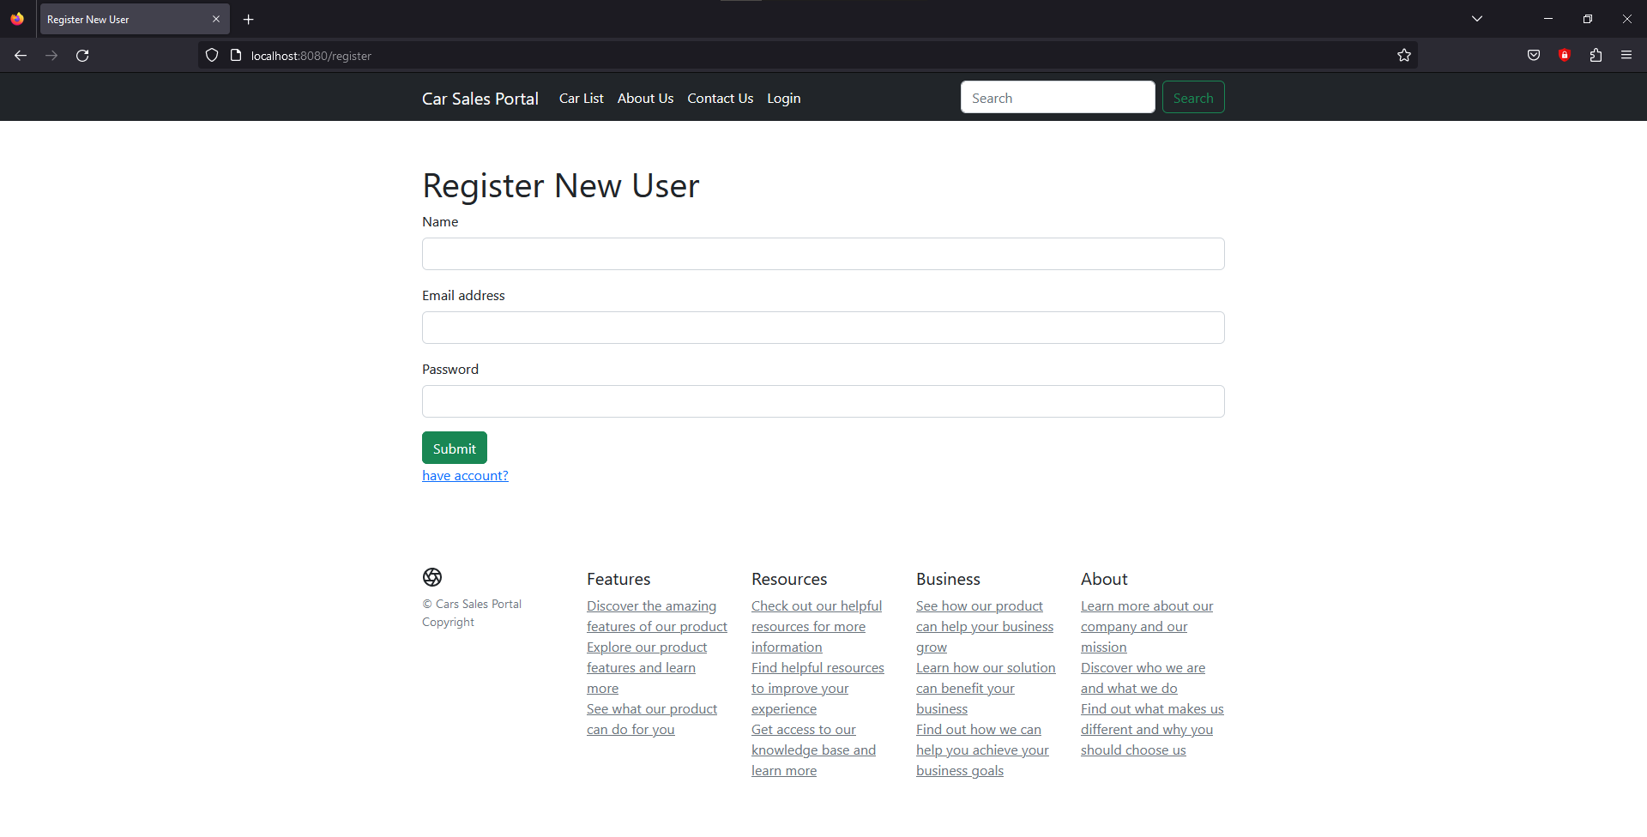
9. Test plans and Test cases
Portability Test
Test Scenario | Portability Test
TS017
Test Cases | Open Cars Sales Portal in three Device
TC001 | Run Cars Sales Portal in Desktop/Laptop
TC002 | Run Cars Sales Portal in Tablet
TC003 | Run Cars Sales Portal in Mobile
Test Scenario ID | Test Case ID | Test Priority | Pre-condition | Expected Result | Actual Result | Pass/ Fail
TS017 | TC001 | Low | The website is published | Cars sales portal still working in three different device | Cars sales portal is working in three different device | Pass
 | TC002
 | TC003
Test Step & Test data | TC001 | Open Cars Sales Portal in Desktop or Laptop
 | TC002 | Open Cars Sales Portal in Tablet
 | TC003 | Open Cars Sales Portal in Mobile

Slide 38
9. Test plans and Test cases
Usability Test
Register
Test Scenario | Usability test of registering in Cars Sales Portal
TS018
Test Cases | Register in Cars Sales Portal
TC001 | User need to register in cars sales portal
Test Scenario ID | Test Case ID | Test Priority | Pre-condition | Expected Result | Actual Result | Pass/ Fail
TS018 | TC001 | low | Any user can access the website | User should be able to register | Users can register without issue | Pass
Test Step & Test data | TC001 | 1.go to cars sales portal 2.click login button 3.click don’t have account 4.fill the form and click submit

Slide 39
9. Test plans and Test cases
Usability Test
Login
Test Scenario | Usability test of login in Cars Sales Portal
TS019
Test Cases | Login in Cars Sales Portal
TC001 | User need to login in cars sales portal
Test Scenario ID | Test Case ID | Test Priority | Pre-condition | Expected Result | Actual Result | Pass/ Fail
TS019 | TC001 | low | Any user can access the website | User should be able to login | Users can login without issue | Pass
Test Step & Test data | TC001 | 1.go to cars sales portal 2.click login button 3. fill the form and click submit

Slide 40
9. Test plans and Test cases
Usability Test
Search
Test Scenario | Usability test of Search of a car in Cars Sales Portal
TS020
Test Cases | Search a car in Cars Sales Portal
TC001 | User need to Search a car in cars sales portal
Test Scenario ID | Test Case ID | Test Priority | Pre-condition | Expected Result | Actual Result | Pass/ Fail
TS020 | TC001 | low | Any user can access the website | User should be able to search a car | Users can search a car without issue | Pass
Test Step & Test data | TC001 | 1.go to cars sales portal 2. type cars make or model in the search form 3. click search

Slide 41
9. Test plans and Test cases
Usability Test
View all Car
Test Scenario | Usability test of liast all car in Cars Sales Portal
TS021
Test Cases | List all car in Cars Sales Portal
TC001 | User need to see list all car in cars sales portal
Test Scenario ID | Test Case ID | Test Priority | Pre-condition | Expected Result | Actual Result | Pass/ Fail
TS021 | TC001 | low | Any user can access the website | User should be able to go to car list page | Users can go to car list page without issue | Pass
Test Step & Test data | TC001 | 1.go to cars sales portal 2. go to car list page by click car list button in the navbar 3. click search

Slide 42
9. Test plans and Test cases
Usability Test
Post a Car
Test Scenario | Usability test of post a car in Cars Sales Portal
TS022
Test Cases | post a car in Cars Sales Portal
TC001 | User need to post a car in cars sales portal
Test Scenario ID | Test Case ID | Test Priority | Pre-condition | Expected Result | Actual Result | Pass/ Fail
TS022 | TC001 | low | Any user can access the website | User should be able to post a car | Users can post a car without issue | Pass
Test Step & Test data | TC001 | 1.go to cars sales portal 2. login as user role account 2. click my store button in the navbar dropdown 3. click sale a car button 4. fill the form and click submit

Slide 43
9. Test plans and Test cases
Security Test
Test Scenario ID | Test Case ID | Test Priority | Pre-condition | Expected Result | Actual Result | Pass/ Fail
TS023 | TC001 | High | Any user can access the website | User input and data in database is matching | Both of the is matching | Pass
 | TC002 |  |  | Send error massage if user input is wrong | The massage is sended if the input is wrong
 | TC003 |  |  | The page will go to forbidden page | It go to forbidden page
 | TC004
 | TC005 |  |  | If the input contain special char in will display error | If the input contain special char in will display error
Test Step & Test data | TC001 | 1.go to cars sales portal 2. click login button 3.fill the form and click submit
 | TC002 | 1. go to car sales portal 2.click login button 3.don’t fill the form and click submit
 | TC003 | 1. got to cars sales portal 2. login as user role 3. go to localhost:8080/list-of-user
 | TC004 | 1. got to cars sales portal 2. login as admin role 3. go to my store page
 | TC005 | 1. go to car sales portal 2.click login button 3.type special char in name input and click submit
Test Scenario | Security Test
TS023
Test Cases | Test the security of Cars Sales Portal
TC001 | Check if the user that currently login really exist in the database
TC002 | Validate user input in login page
TC003 | Check if user role can’t access adiministration panel
TC004 | Check if admin role can’t post a car
TC005 | Check if the input mustn’t have any special character for sql injection

Slide 44
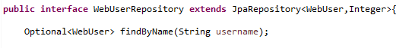
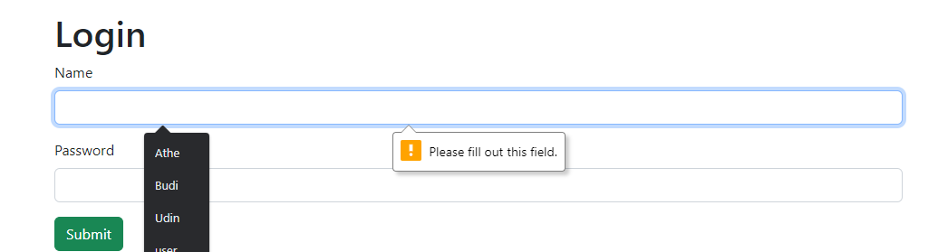
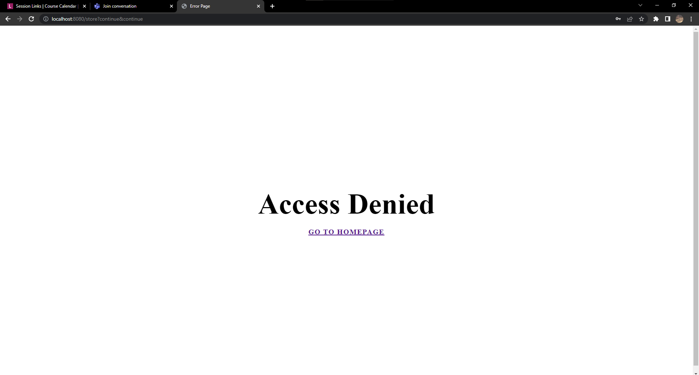

9. Test plans and Test cases
Security Test

Slide 45
10. Logs of Test Results
 | Used Car Sale Portal Project
Reported By: | Kadek Adi Astawa
Report Date: | 2/16/2023
Tested By: | I Kadek Adi Astawa
Tested Date: | 2/16/2023
Testing Name/ Test Scenario ID | UAT Testing/ TS001 / TS002 / TS003 / TS004 /TS005
Total Number of Test Cases | 10
No. of Pass: | 10
No. of Failures: | 0
Elapsed Time: | 20 minutes
Tested By: | Kadek Adi Astawa
Tested Date: | 2/16/2023
Testing Name/ Test Scenario ID | Unit Testing/ TS006 / TS007 / TS008 / TS009 / TS010
Total Number of Test Cases | 5
No. of Pass: | 3
No. of Failures: | 2
Elapsed Time: | 32 minutes
Tested By: | Kadek Adi Astawa
Tested Date: | 2/16/2023
Testing Name/ Test Scenario ID | Performance Testing/ TS011
Total Number of Test Cases | 2
No. of Pass: | 2
No. of Failures: | 0
Elapsed Time: | 6 minutes
Tested By: | Kadek Adi Astawa
Tested Date: | 2/16/2023
Testing Name/ Test Scenario ID | Compatibility Testing/ TS0012 / TS013 / TS014 / TS015 / TS016
Total Number of Test Cases | 15
No. of Pass: | 15
No. of Failures: | 0
Elapsed Time: | 20 minutes
Tested By: | Kadek Adi Astawa
Tested Date: | 2/16/2023
Testing Name/ Test Scenario ID | Usability Testing/ TS018 / TS019 / TS020 / TS021 / TS022
Total Number of Test Cases | 5
No. of Pass: | 5
No. of Failures: | 0
Elapsed Time: | 12 minutes
Tested By: | Kadek Adi Astawa
Tested Date: | 2/16/2023
Testing Name/ Test Scenario ID | Security Testing/ TS023
Total Number of Test Cases | 5
No. of Pass: | 5
No. of Failures: | 0
Elapsed Time: | 10 minutes

Slide 46
10. Logs of Test Results
Tested By: | Kadek Adi Astawa
Tested Date: | 2/16/2023
Testing Name/ Test Scenario ID | Portability Testing/ TS017
Total Number of Test Cases | 3
No. of Pass: | 3
No. of Failures: | 0
Elapsed Time: | 5 minutes
SUMMARY LOG STATUS
Total Number of Test Cases | 45
Total Number of Pass | 43
Total Number of Failures | 2
Pass % | 95.56%
Total Elapsed Time | 105 minutes

Slide 47


11. Modification of fail test
Registration Scenario (After Modification)
Test Scenario | Registration Page
TS006
Test Cases | Registration Functionality
TC001 | The data from registration form should be inserted to the database
Test Scenario ID | Test Case ID | Test Priority | Pre-condition | Expected Result | Actual Result | Pass/ Fail
TS006 | TC001 | High | Any user can access the website | The data should be inserted to the database | The data is stored in database | Pass
Test Step & Test data | TC001 | 1.Create Registration Method 2.create new object user with user data inside of it. 3.use service to insert the data 4.run test cases

Slide 48


11. Modification of fail test
Search Car Scenario (After Modification)
Test Scenario | Search Page
TS008
Test Cases | Search Functionality
TC001 | Search for a Car
Test Scenario ID | Test Case ID | Test Priority | Pre-condition | Expected Result | Actual Result | Pass/ Fail
TS008 | TC001 | Moderate | Any user can access the website | Display the searched car | Car displayed like what user search | Pass
Test Step & Test data | TC001 | 1.Create Search Method 2.create new object car. 3.use service to search car. 4.run test cases

Slide 49
11.Modification of fail test cases
Log Result After Modification
Project ID/ Project Name: | Used Car Sale Portal Project
Reported By: | Kadek Adi Astawa
Report Date: | 2/16/2023
Tested By: | Kadek Adi Astawa
Tested Date: | 2/16/2023
Testing Name/ Test Scenario ID | UAT Testing/ TS006 / TS008
Total Number of Test Cases | 2
No. of Pass: | 2
No. of Failures: | 0
Elapsed Time: | 9 minutes
SUMMARY LOG STATUS
Total Number of Test Cases | 2
Total Number of Pass | 2
Total Number of Failures | 0
Pass % | 100%
Total Elapsed Time | 9minutes

Slide 50
13. Project Results
Home Page

Slide 51

13. Project Results
Login Page

Slide 52

13. Project Results
Registration Page

Slide 53

13. Project Results
About Us Page

Slide 54

13. Project Results
Contact Us Page

Slide 55


13. Project Results
Car List Page

Slide 56


13. Project Results
Bid Car List Page

Slide 57

13. Project Results
Car Detail Page

Slide 58

13. Project Results
My Store Page

Slide 59

13. Project Results
Add Car Page

Slide 60

13. Project Results
Add Bid Car Page

Slide 61

13. Project Results
Edit Car Page

Slide 62

13. Project Results
Profile Page

Slide 63

13. Project Results
Update Profile Page

Slide 64

13. Project Results
Administration Panel Page

Slide 65

13. Project Results
Error Page

Slide 66
Thank you
Thank you..

